Slide 1


Governance Board Meeting
May 22, 2023

Slide 2
Welcome
Steve Nash

Slide 3
Mission Moment
Nikki Kalvin

Slide 4
Chairman’s Report
Steve Nash

Slide 5
Minutes and Agenda
Welcome - May Board Meeting
  Chairman’s Report
  Program Update
  Finance Report
  Advancement Update
  Strategic Discussions:
    Board Development
  Open Business
  Adjourn
Approval
of
March
Minutes

Slide 6

Executive Committee Update
Review of operations
New Facility Update
Building Fund intention (vote)
  Recommend no restrictions
Board appreciation to Paul

Slide 7
Program Update
Mark McNamer | Anna VonRueden

Slide 8

Program Update
Program Committee
  Focus on Mental Health Connections, Educational Opportunities,
  Employment/Vocational Programing
New FHPAP Dollars
Official signed new contract with TreeHouse
Continued development of Program Policies and Procedures

Slide 9
Financial Report
Brooke Limanen | Don Phillips

Slide 10
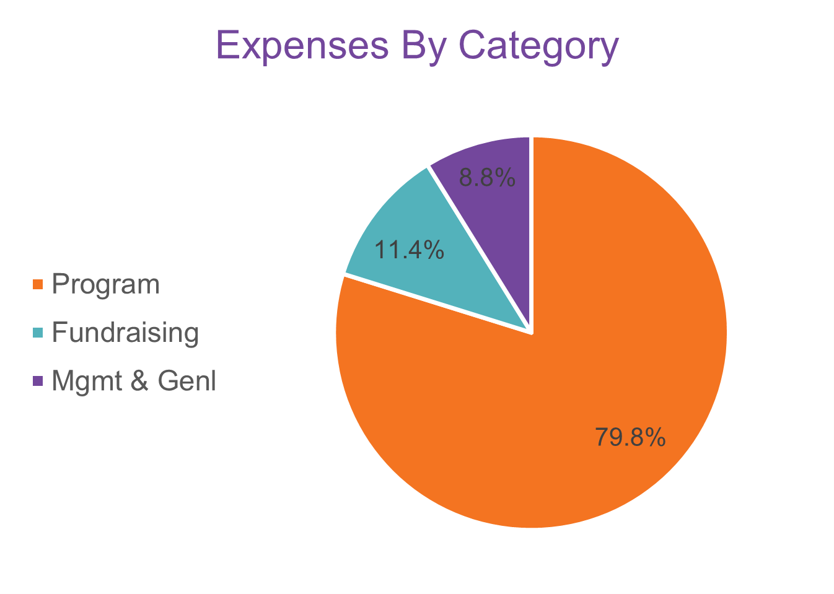
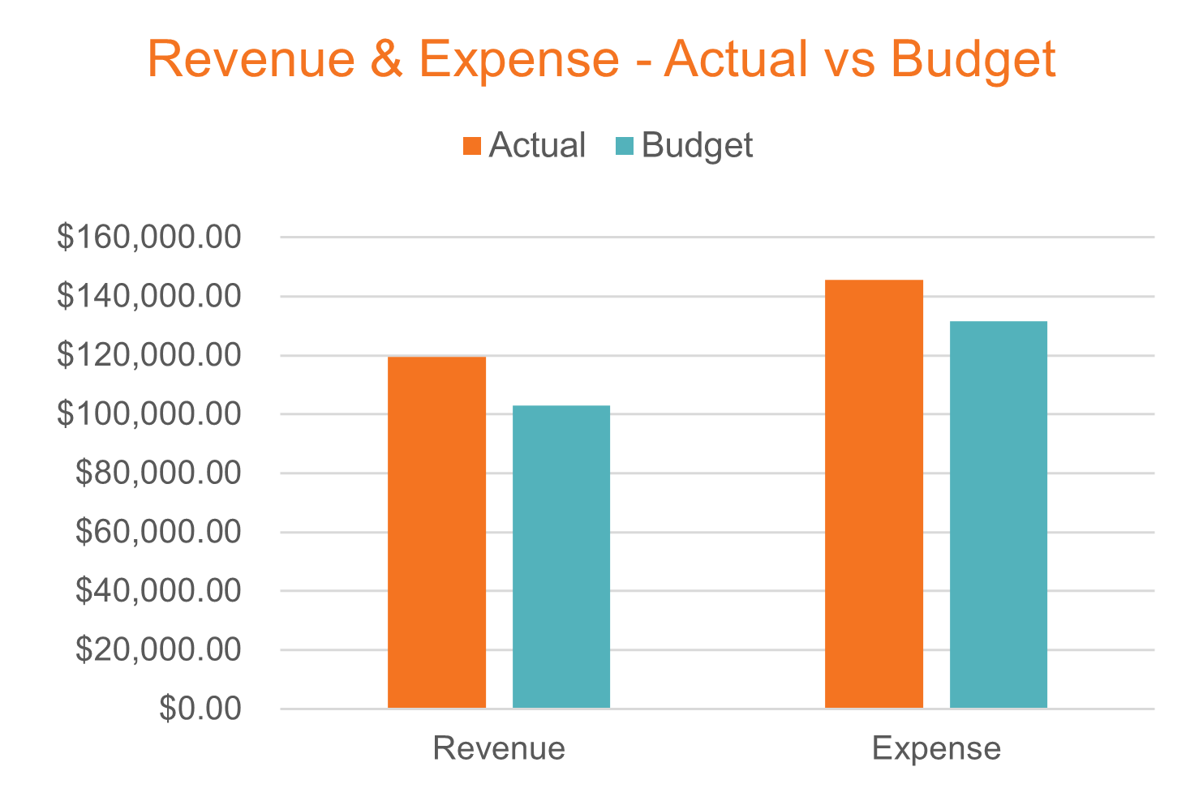
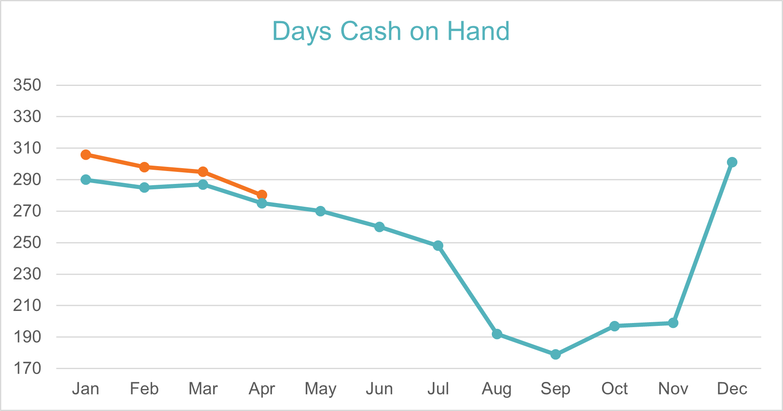
Finance Snapshot
April 2023

Slide 11
Advancement Update
Nikki Kalvin | JJ Slag

Slide 12
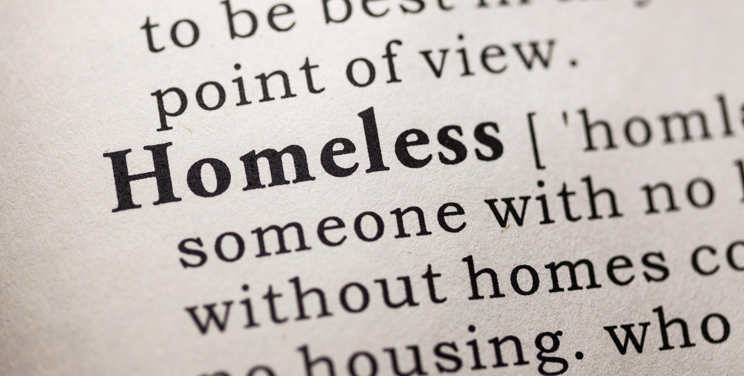

Advancement Update
Fundraising, Marketing and Events
  A Night 4 HOPE – raised over $170,000
  Website updates – 6-week project
  New One pager
  Summer Appeal – Parenting Youth
  Fall events on the horizon
    Heartland Tire Golf Classic
    Darkest Night 4K
    Hunt 4 HOPE
    Clays 4 Youth
    Inspiring HOPE breakfast

Slide 13

Advancement Update
Community Engagement and Volunteers
  Speaking engagements
  Community Outreach
    Stepping Up 4 HOPE
    Running Aces
    Ramsey Happy Days
  Volunteer Program
    New Manuals
    New job descriptions
    Updated group volunteering
    New Donations opportunities

Slide 14
Board Development
LaChelle Williams

Slide 15
Gap Analysis
Industry needs
  Finance – NP
  Larger business
Competency needs
  Fundraising
  Construction
  Mission | Program
Leadership needs
  Community Influencers

Slide 16

Working Together
Board | Committee Responsibilities
New Facility Vision
Location strategy
Funding strategy
Financial oversight
RFP process; Architect | Construction
Staff Responsibilities
Legislative arena
Community launch
Building design
Operational direction
Program vision and partnership development

Slide 17
Brainstorming

Slide 18

Elevation and Nominations
Bring forward nominee to LaChelle
Exec and Nomination Committees with LaChelle will vet
Determine best person to make ask
Onboard new board member
Questions?

Slide 19
Open Business
All

Slide 20

CELEBRATION!!!

Slide 21


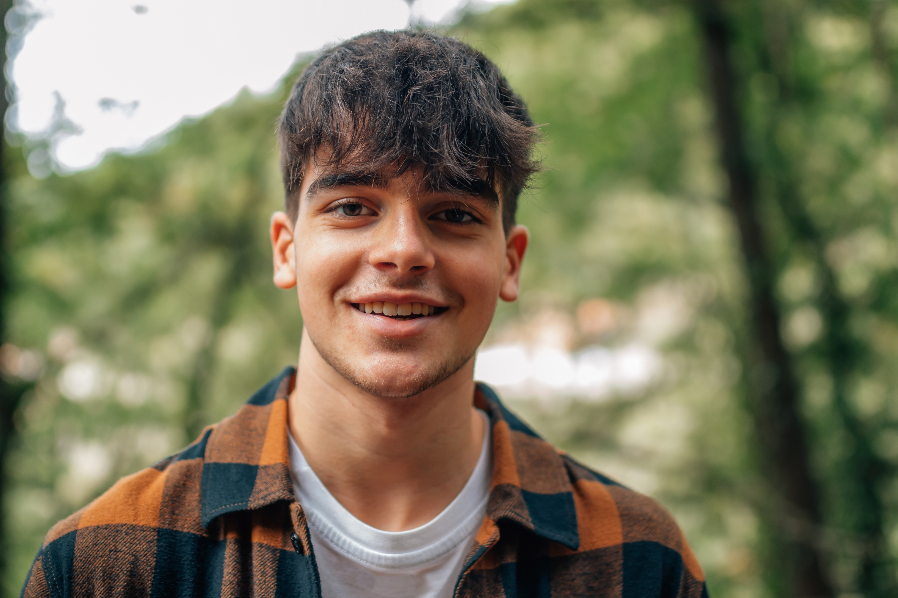
Thank You!

