Slide 1


Governance Board Meeting
March 27, 2023

Slide 2
Welcome
Steve Nash

Slide 3
Mission Moment
Mikaela – HOPE 4 Youth Team Member

Slide 4
Chairman’s Report
Steve Nash

Slide 5
Minutes and Agenda
Welcome - March Board Meeting
  Chairman’s Report
  Strategic Discussions:
    2022 Program results
    Board Development
  Ed update
  Finance update
  Advancement update
  Open Business
  Adjourn
Approval
of
January
Minutes

Slide 6

Executive Committee Update
Thank you!
Board Committees
Board Reserve Policy (vote)
Board Reserve Plan (vote)
Support of our friend Sue

Slide 7
2022 Program Results
Mark McNamer

Slide 8


Slide 9


Slide 10


Slide 11
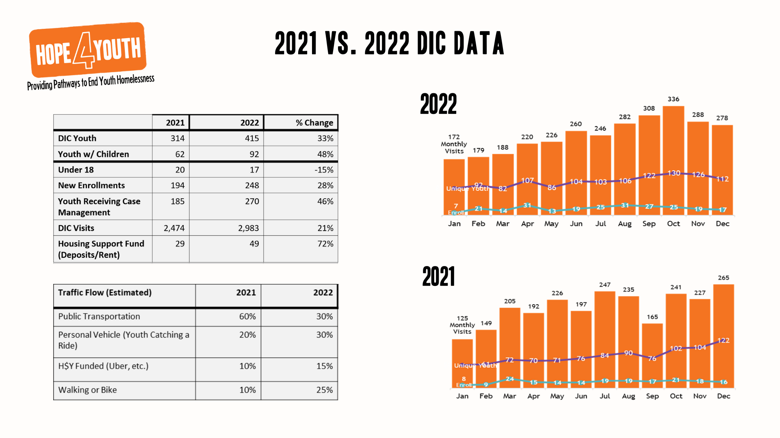

Slide 12


Slide 13
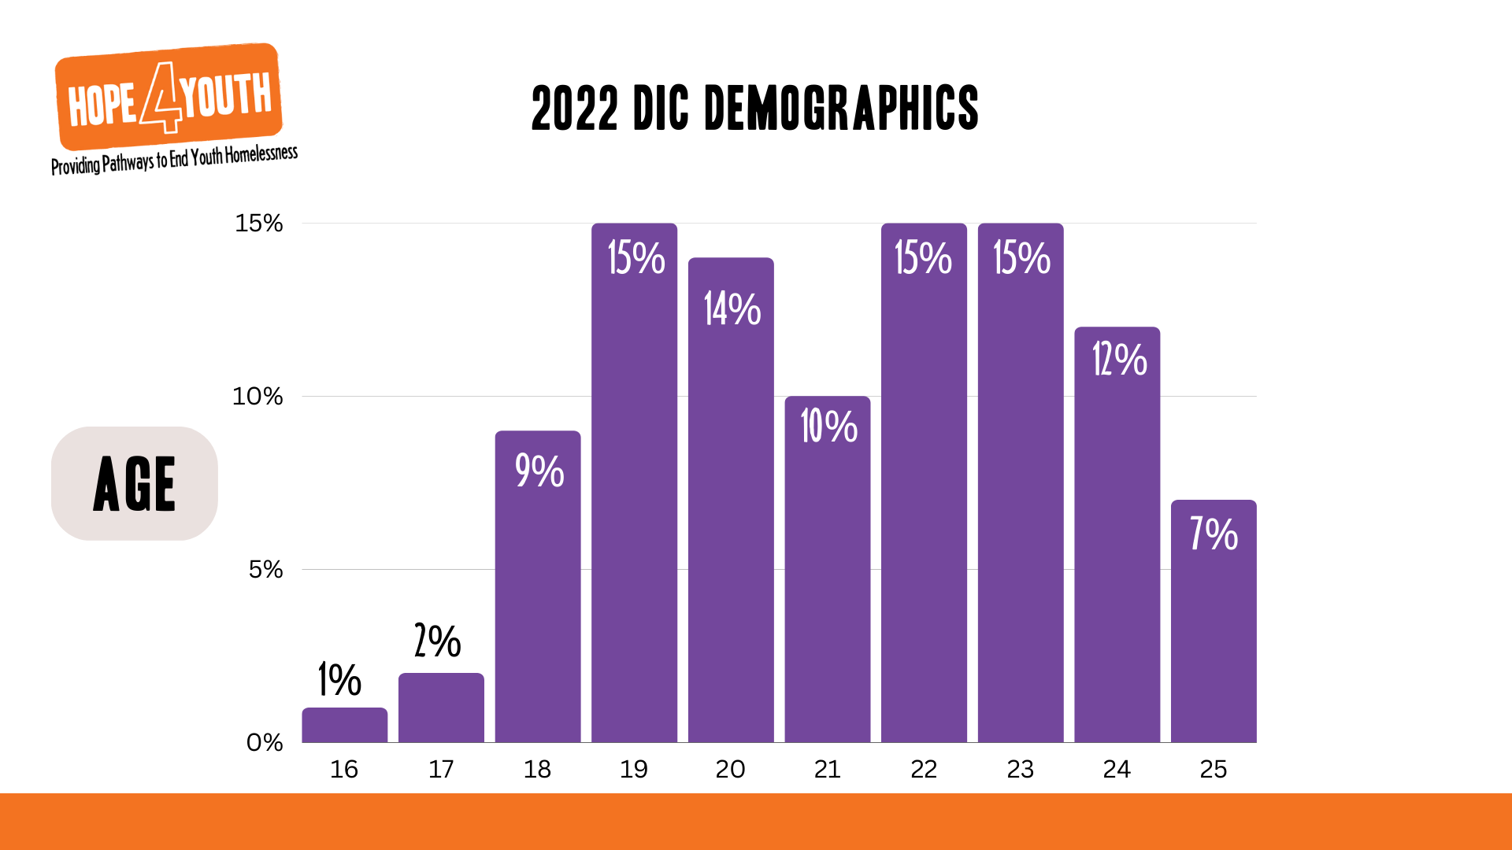

Slide 14
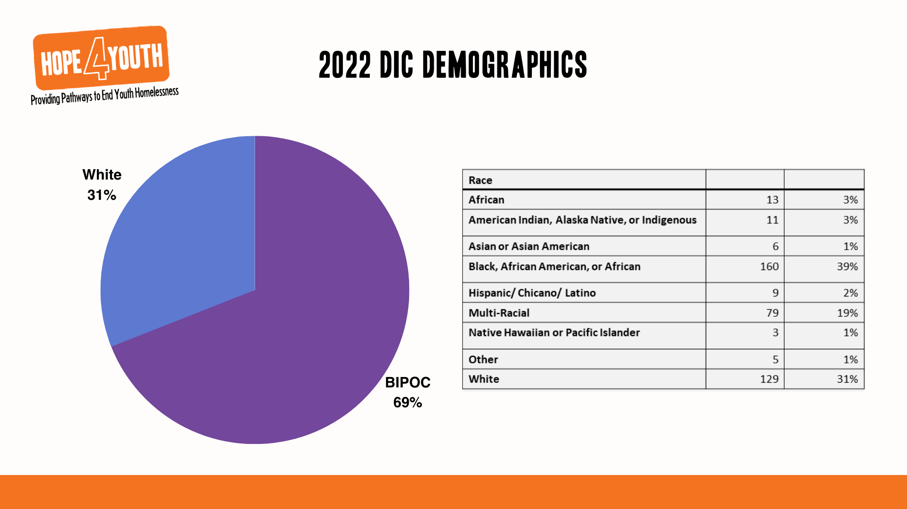

Slide 15
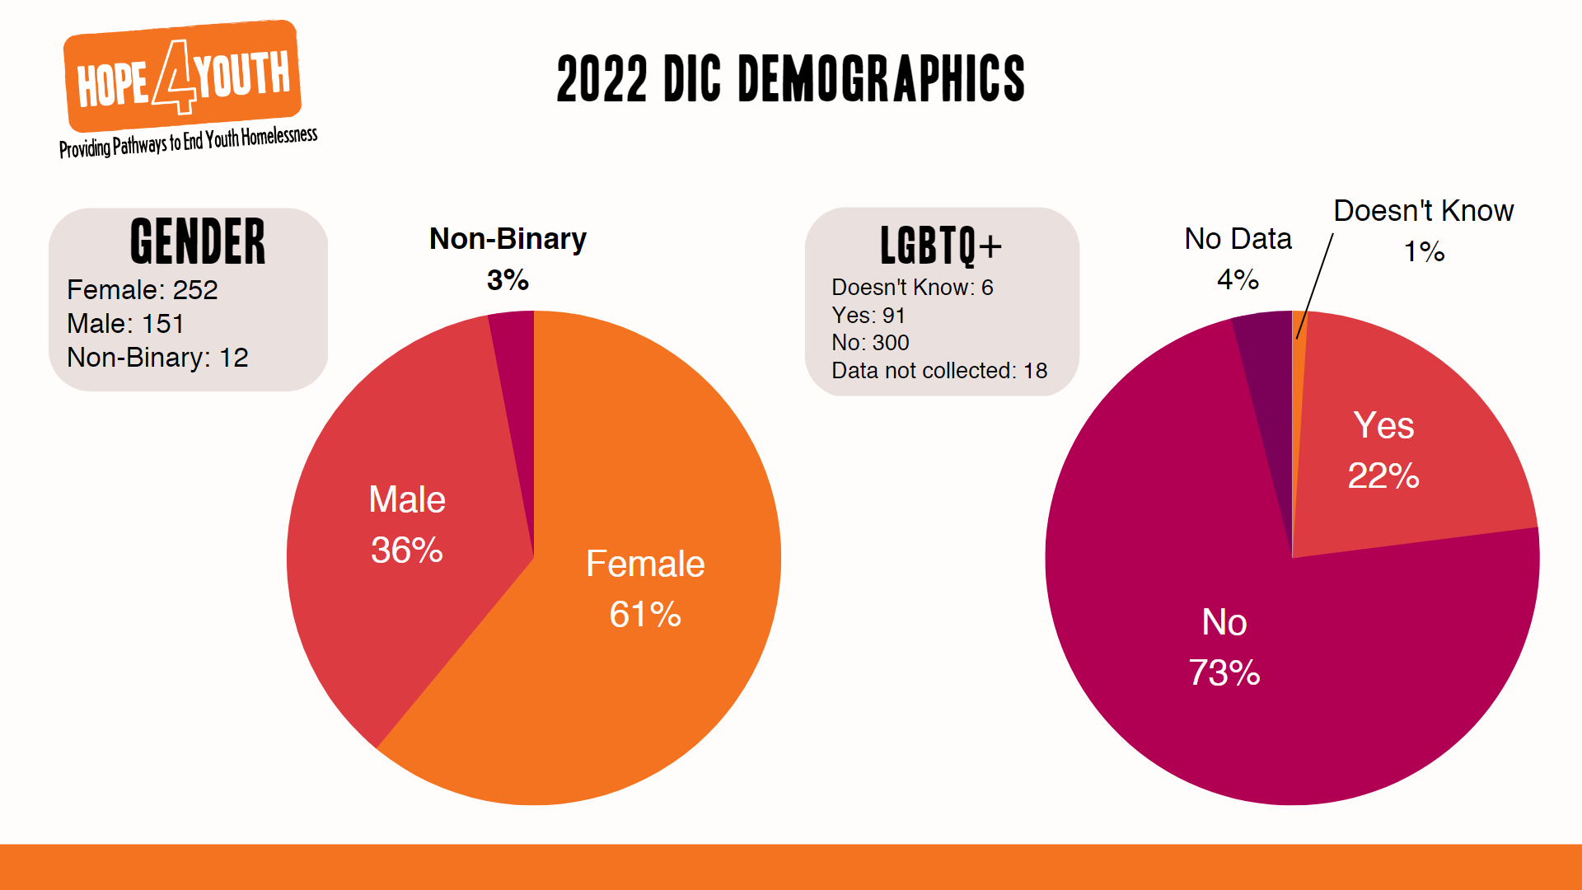

Slide 16
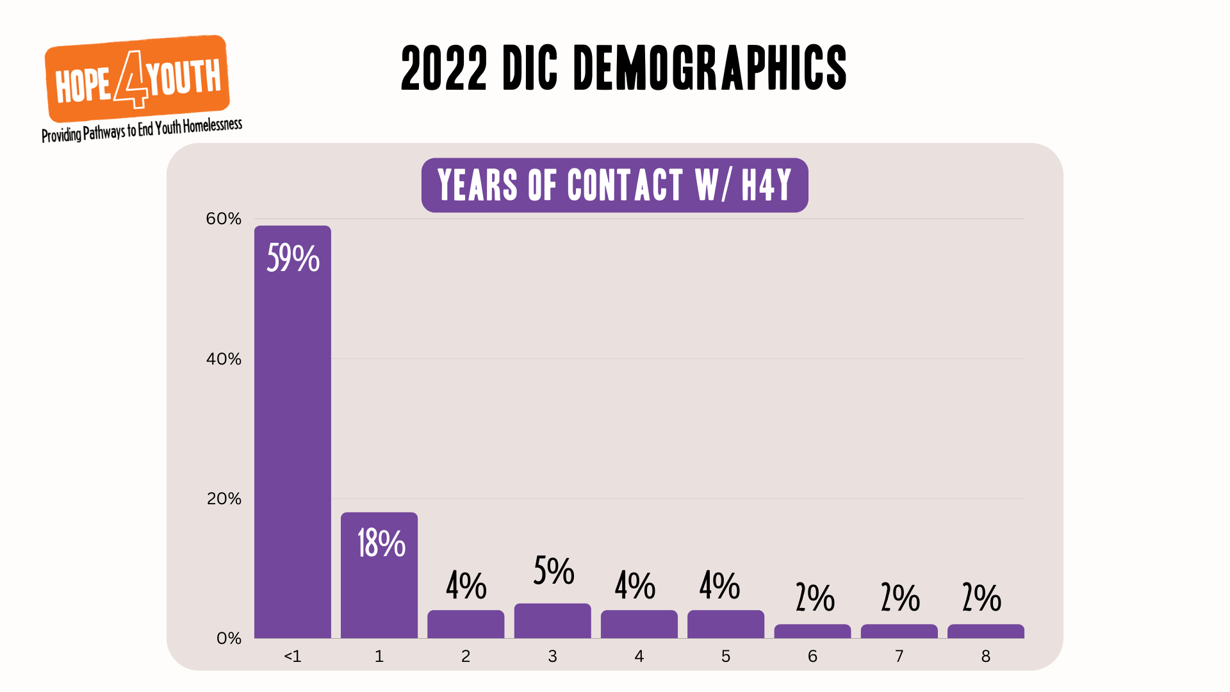
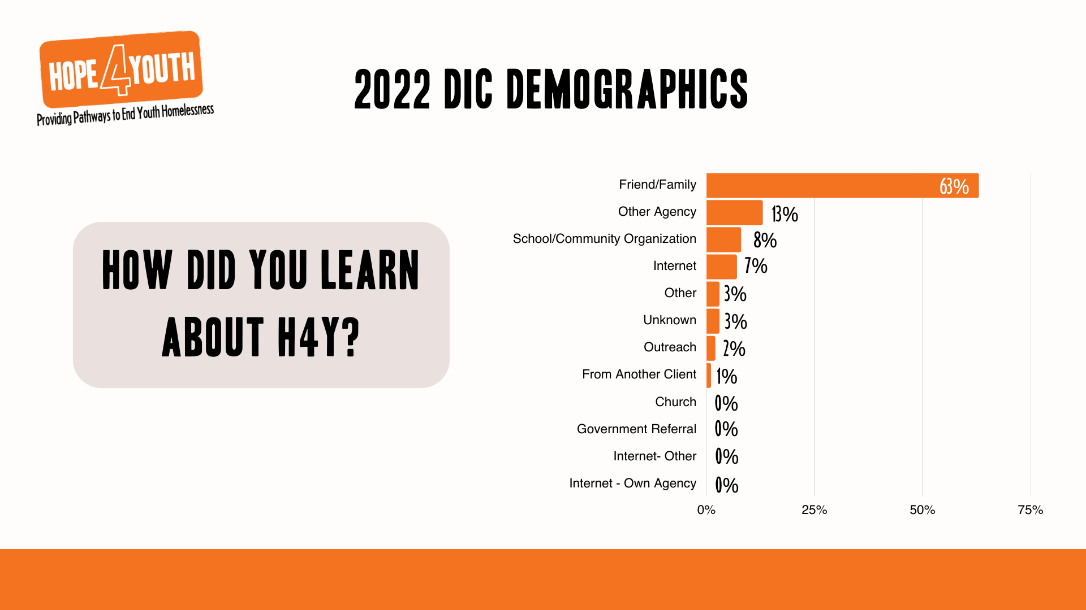
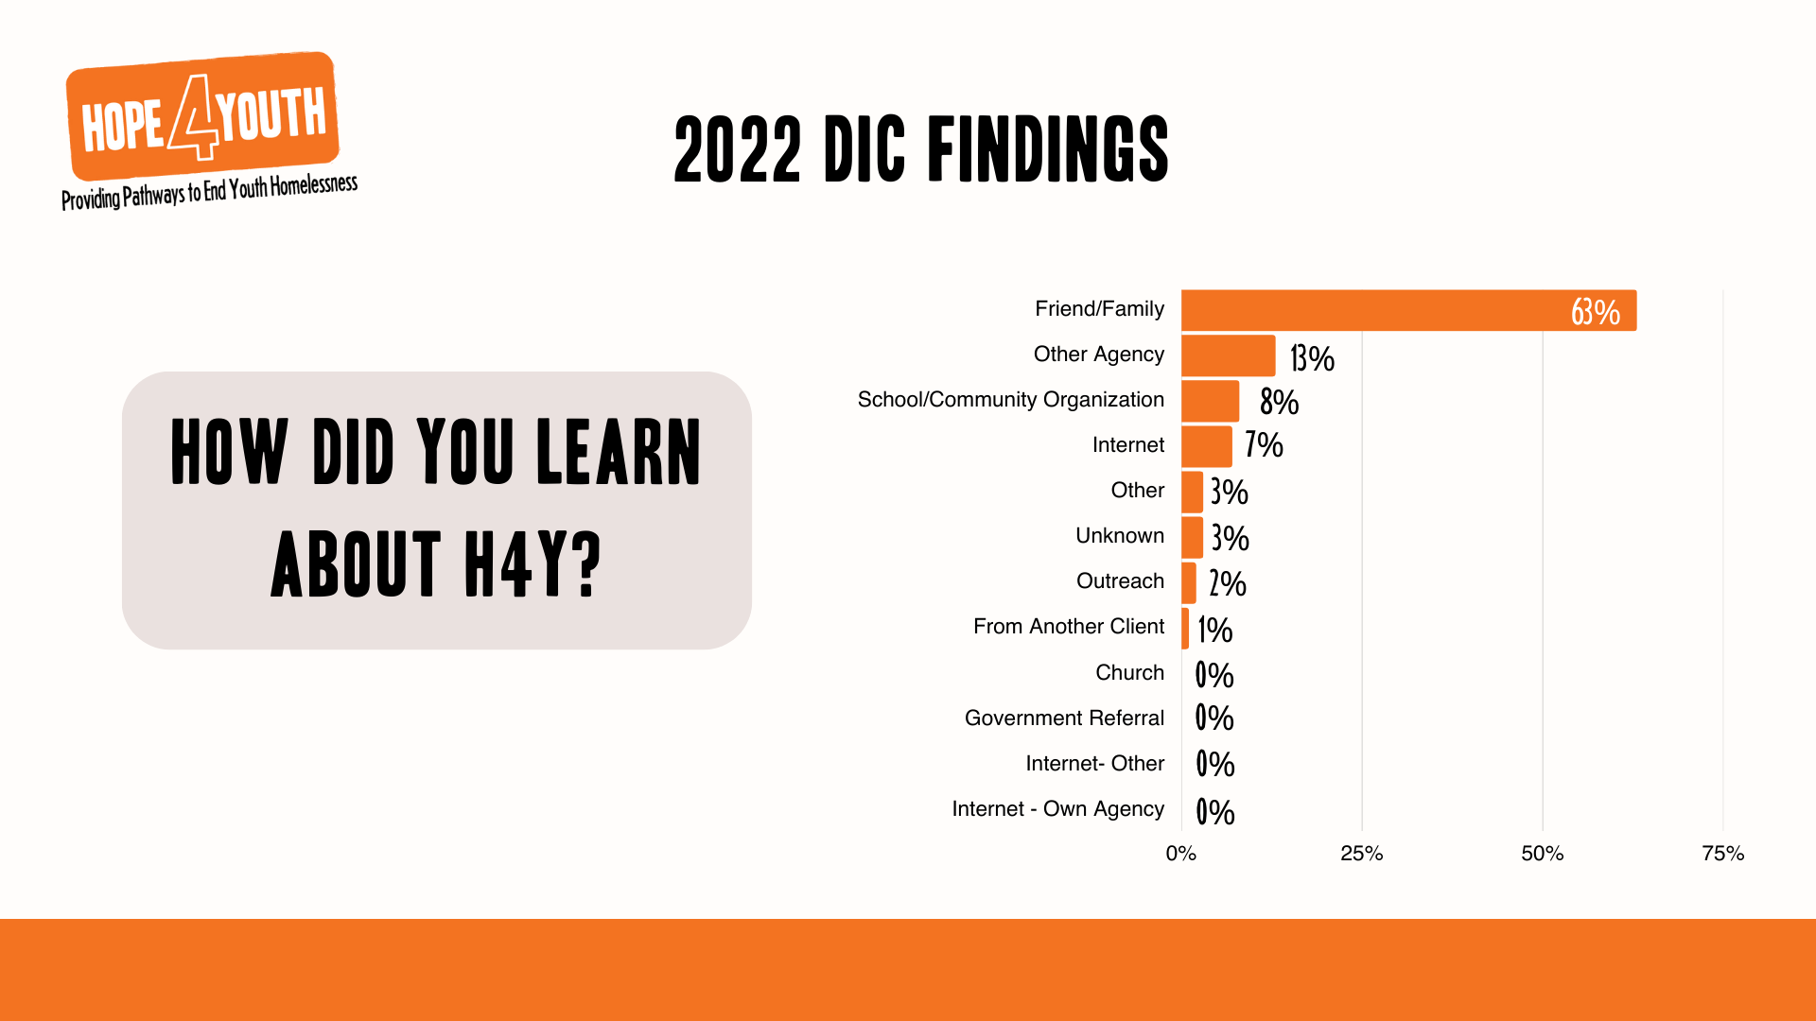

Slide 17



Slide 18


Slide 19


Slide 20


Slide 21


Slide 22


Slide 23
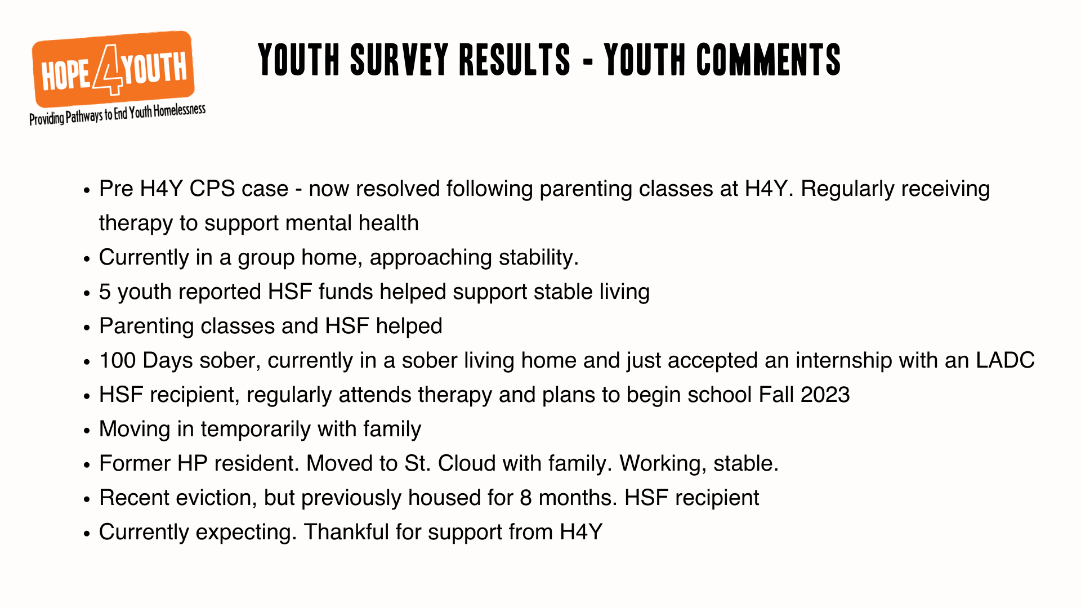

Slide 24


Slide 25
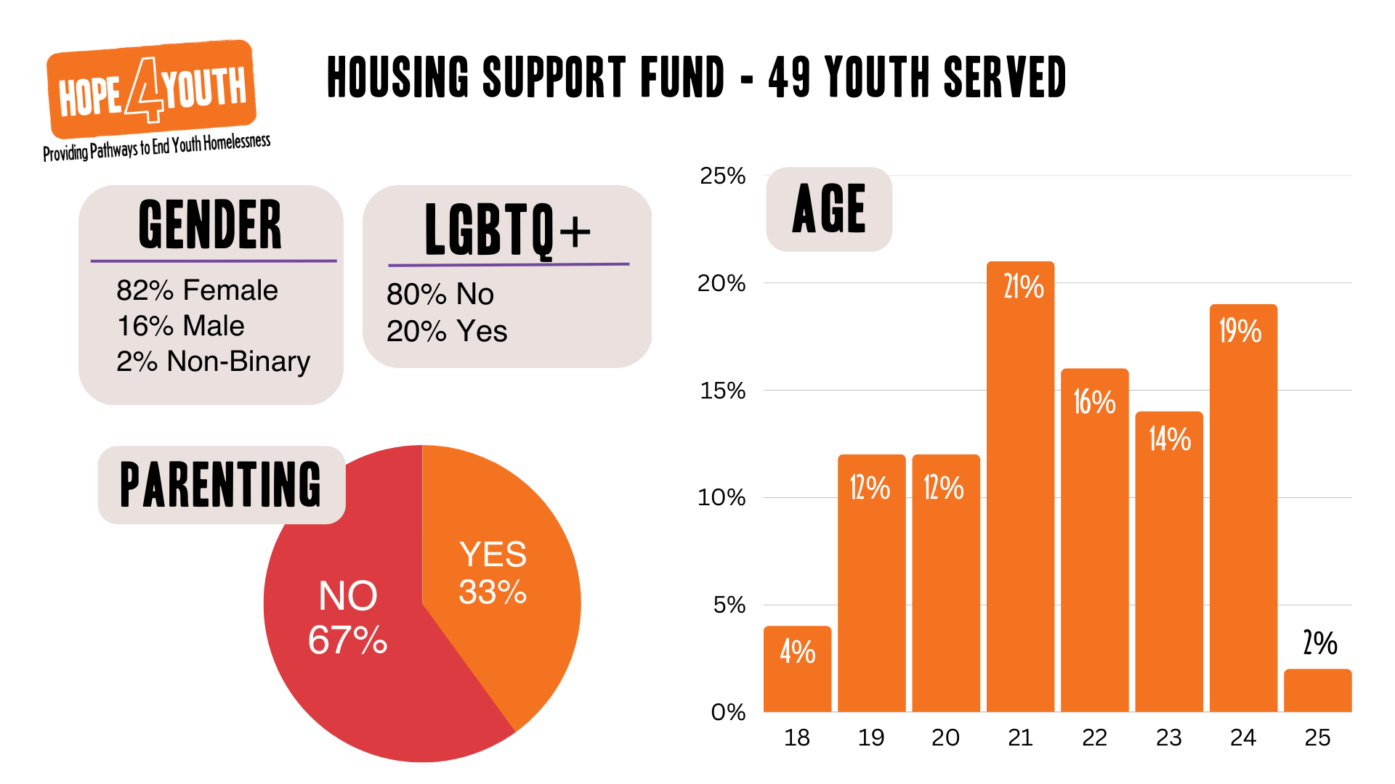

Slide 26
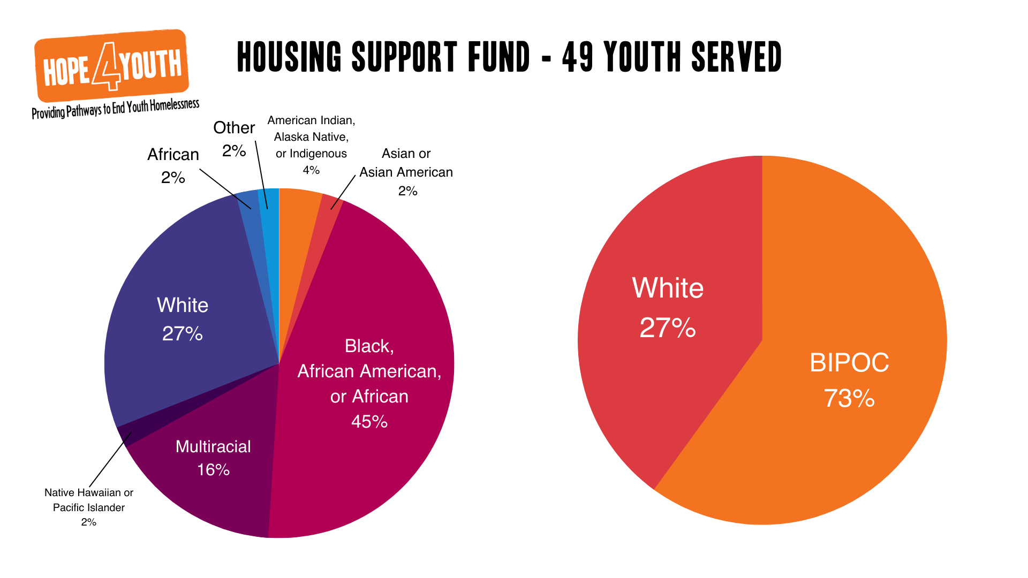

Slide 27


Slide 28


Slide 29


Slide 30
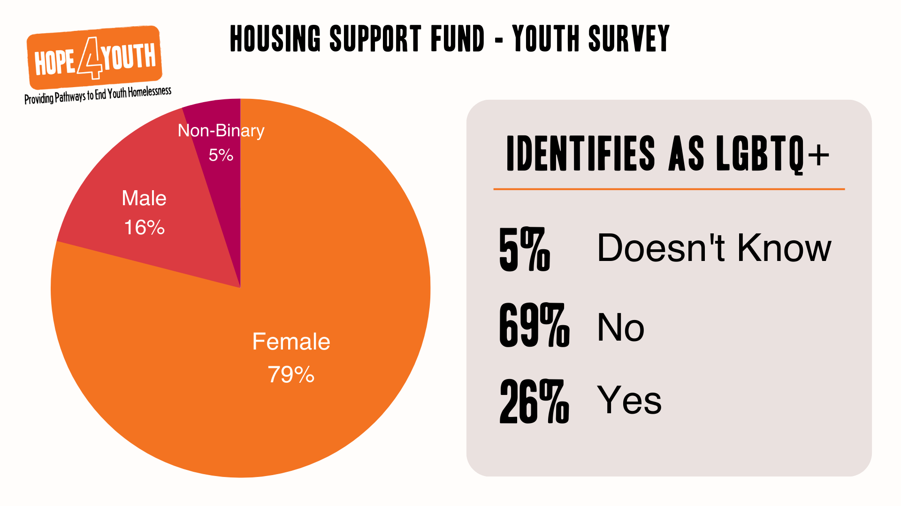

Slide 31


Slide 32


Slide 33
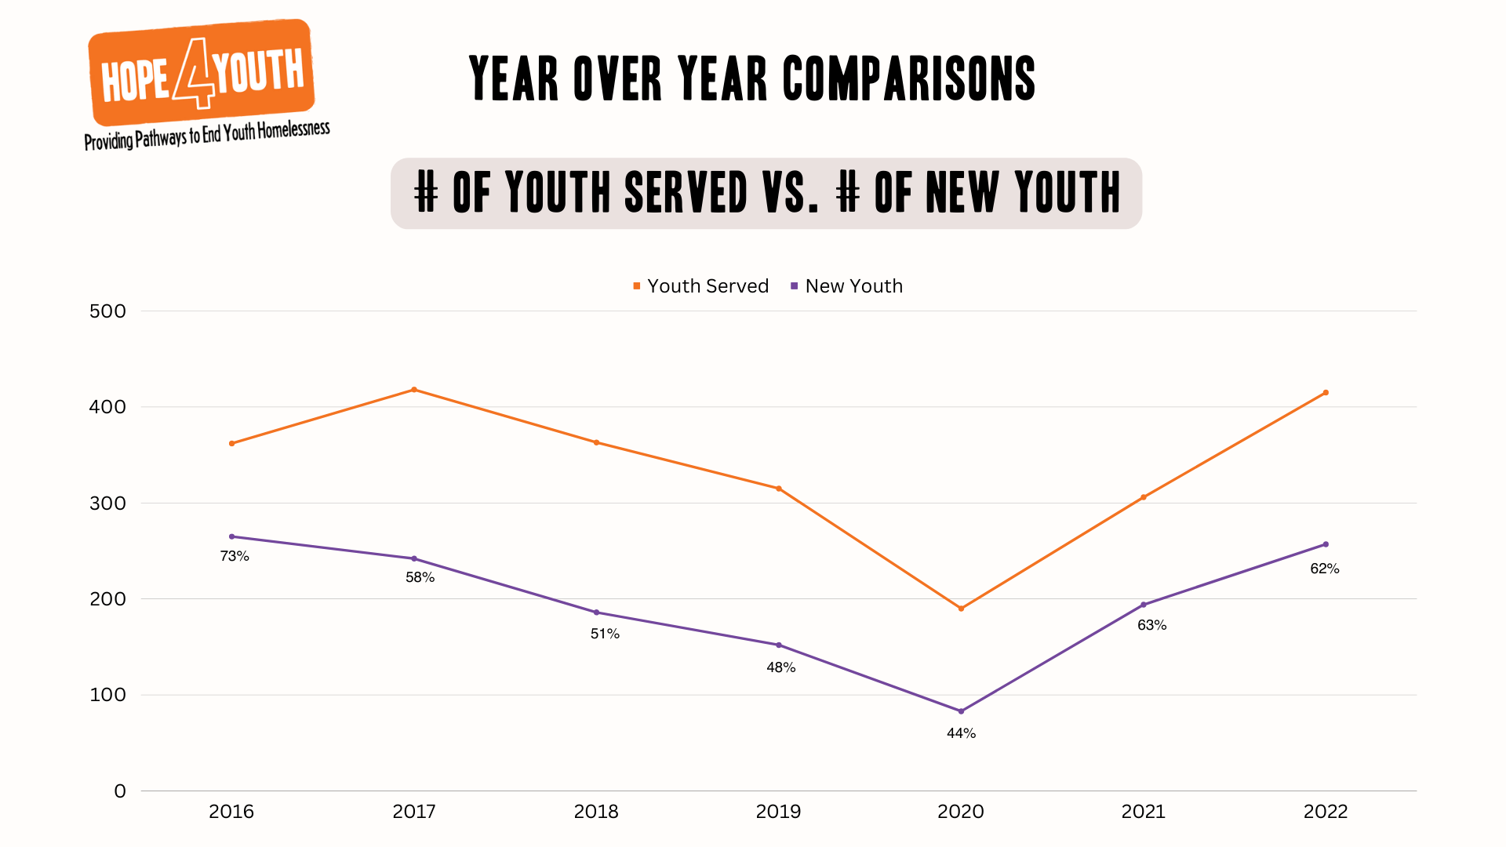

Slide 34
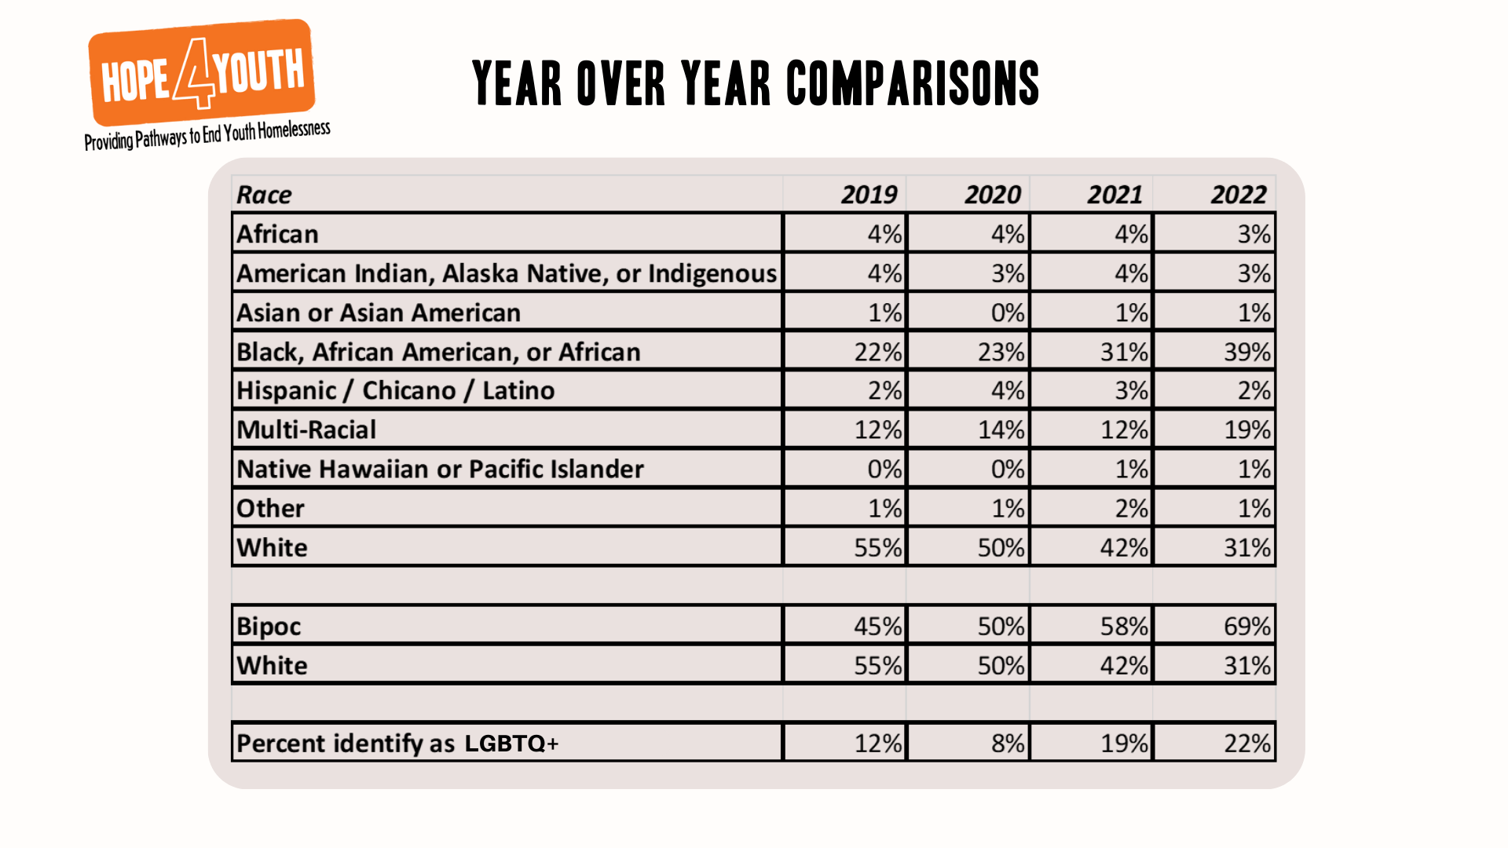

Slide 35
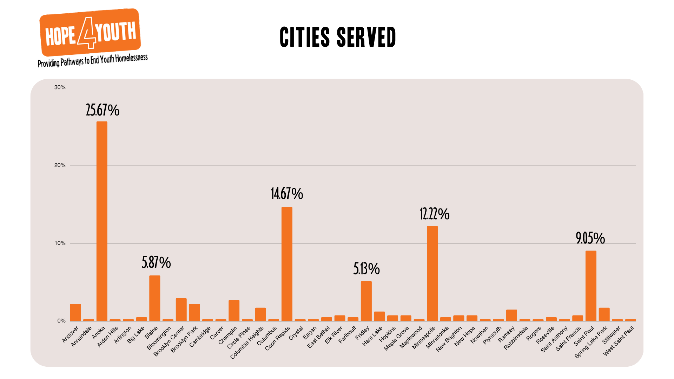

Slide 36
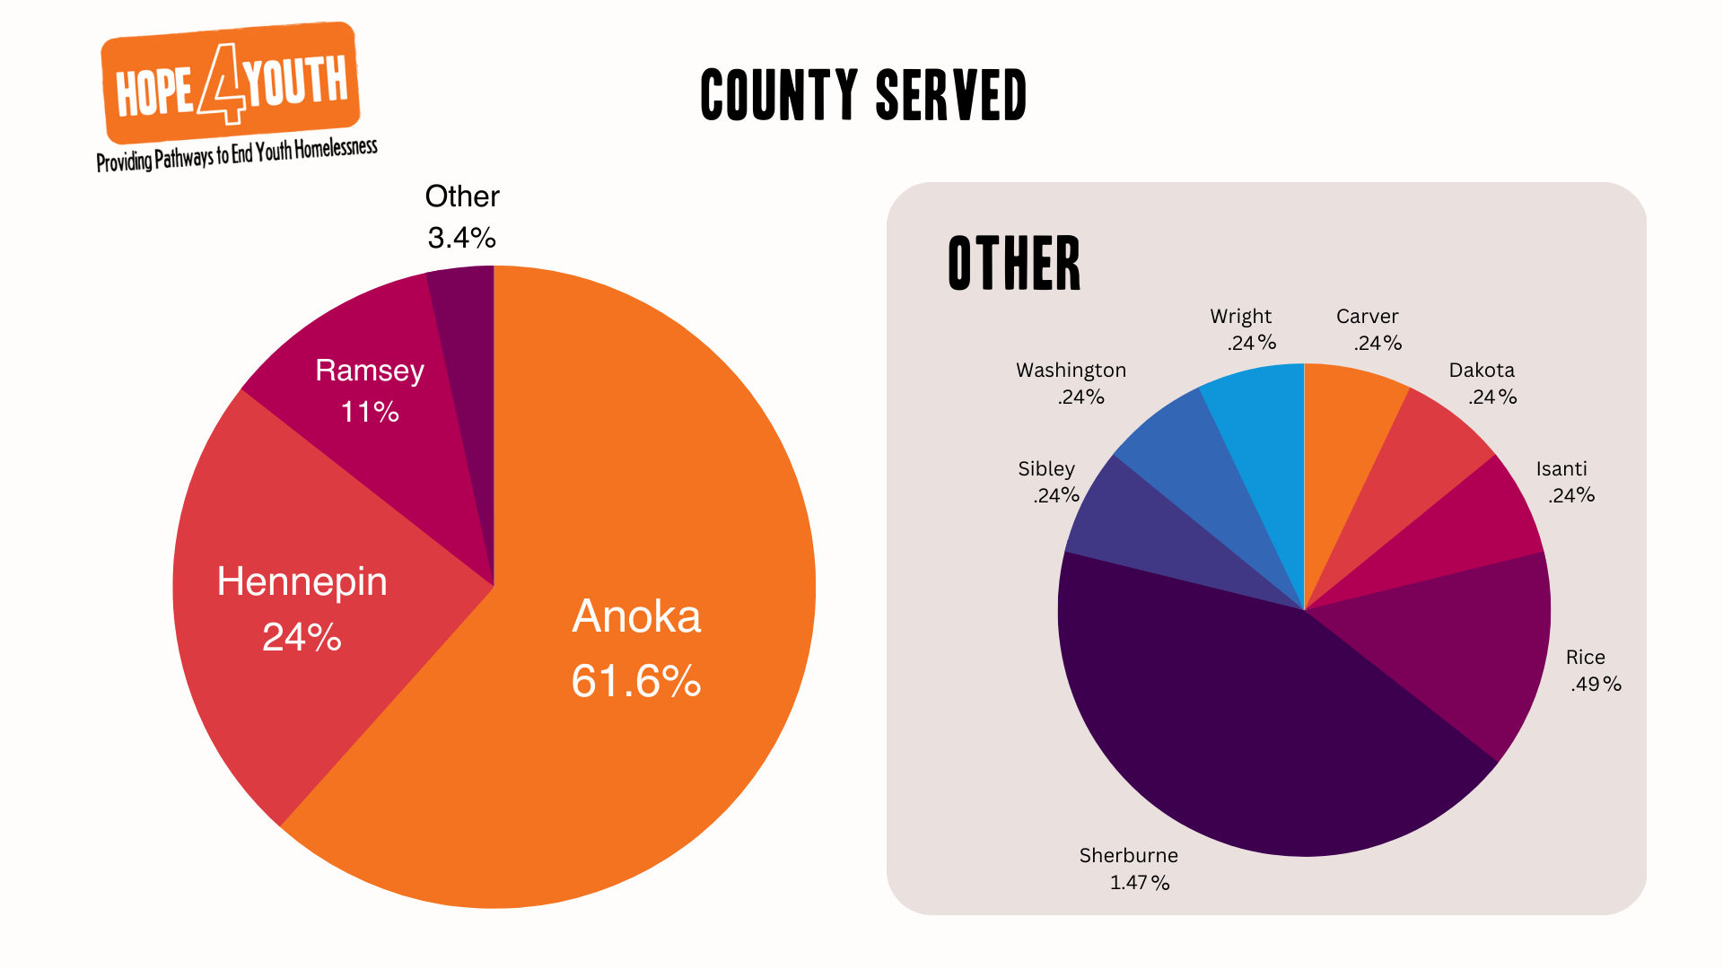

Slide 37


Slide 38
Board Development
LaChelle Williams

Slide 39

Gap Analysis
Industry needs
  Finance – NP
  Larger business
Competency needs
  Fundraising
  Construction
  Program
Leadership needs
  Community Influencers

Slide 40

Elevation and Nominations
Bring forward nominee to LaChelle
LaChelle with vet with committees
Determine best person to make ask
Onboard new board member
Questions?

Slide 41
ED Update
LaChelle Williams

Slide 42

Operational Momentum
General updates
  Board 1:1s
  Staff updates
  Process improvement
New Facility update
  House – IN |Senate - Pending
  New name for Drop-In Center

Slide 43
Finance Report
Brooke Limanen | Don Phillips

Slide 44
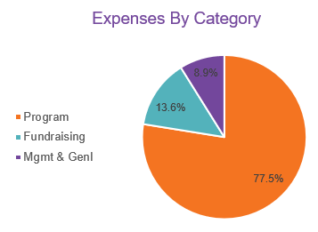
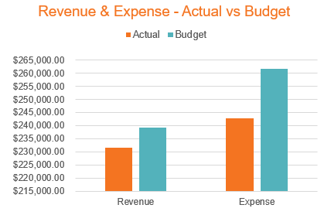
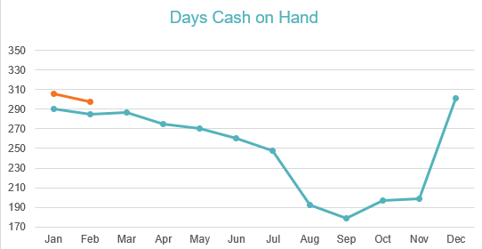
Finance Snapshot
February 2023

Slide 45
Advancement Update
Nikki Kalvin | JJ Slag

Slide 46

Advancement Update
Fundraising
  Donations, Gifts and Grants
  Donor Stewardship Process
Community Engagement and Volunteers
  Donations process
  New Partnerships
  Outreach Engagements
Marketing and Events
  New brand standards and presentation
  10 Years of Building HOPE messaging
  Special Event strategies

Slide 47

Advancement Update
Action Items:
Additional sponsors needed
Invite guests to purchase a table/ buy tickets
Share on social media
Silent Auction items
Board Live Auction Item
Vision and Night of Event
Sponsors and Tickets
Live Auction / Silent Auction

Slide 48
Open Business
All

Slide 49


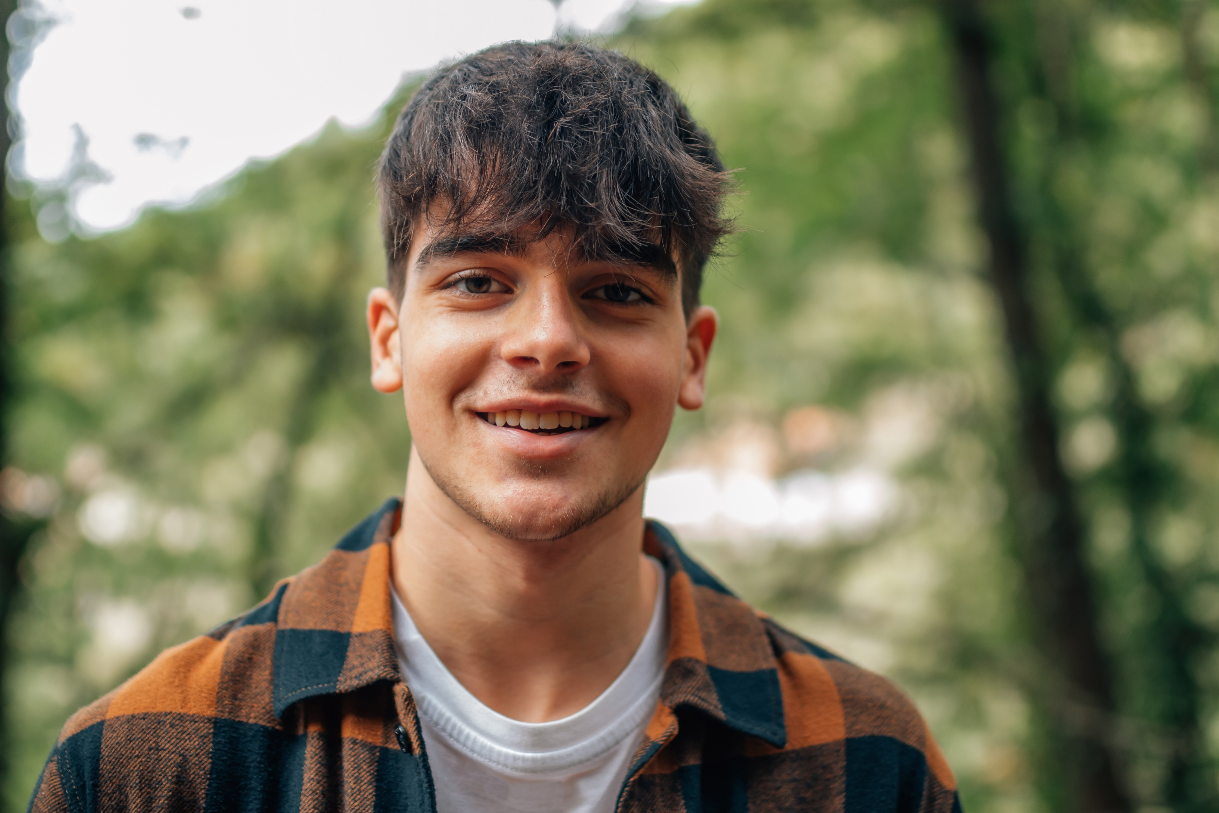
Thank You!

