Slide 1


Governance Board Meeting
November 27, 2023

Slide 2
Welcome
Steve Nash
Share: your connection to H4Y * how long on board * one Fall favorite

Slide 3
Mission Moment
Mark McNamer

Slide 4
Chairman’s Report
Steve Nash

Slide 5
Minutes and Agenda
Welcome - November Board Meeting
  Chairman’s Report
  Strategic Discussion | Operational Updates:
    2024-2026 Strategic Plan approval
    Finance Committee review
    New Facility Update
  ANNUAL MEETING
    Slate of Officers – Approval
    2024 budget presentation
  Adjourn
  EXECUTIVE SESSION
Approval
of
September
Minutes

Slide 6

Executive Committee Update
Recap of the 2023
Board resolution – Retirement Contribution
Your time and talent
Rounding out the board
  Fundraising/Marketing passion
New Market Tax Credit vetting
Outgoing Board Member appreciation

Slide 7
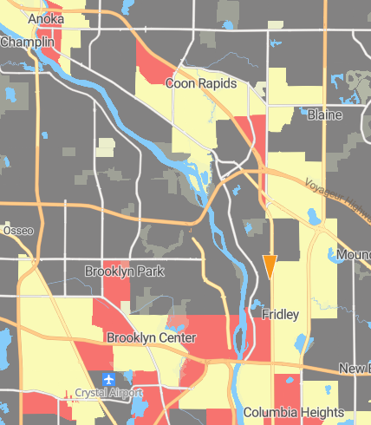
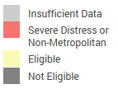
New Facility - Location
New Market Tax Credit Track

Slide 8
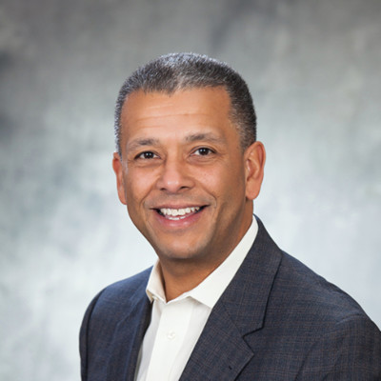
Thank you
Stephen Spears

Slide 9
Building our FUTURE
Sue Woodard | Strategic Steering Committee

Slide 10
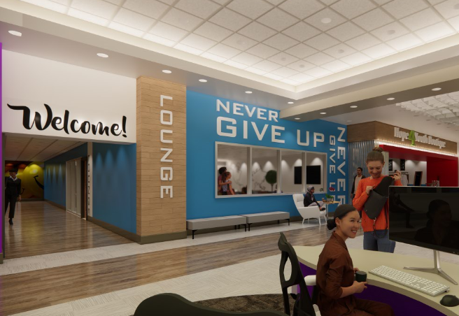

2024-2026 Strategic Plan
Board & Committee Review
Strategic Plan Approval
Risk Management Plan process

Slide 11
Strategic Goal & Objectives: One
NO CHANGES
  Provide life-enhancing programs empowering youth to reach their full potential
    Deliver premier programs using the four-fold approach
    Create a center of support at the Drop-In Center addressing immediate and long-term needs
    Create a thriving place to live at HOPE Place to fully launch youth into the community
    Expand social & emotional well-being program offerings and resource partnerships

Slide 12
Strategic Goal & Objectives: Two
NO CHANGES
  Engage in transformational partnerships with community leaders, donors, and volunteers
    Strengthen partnerships with community leaders focused on homelessness and youth empowerment to provide imperative resources for our youth
    Enhance donor relations to build transformational relationships
    resulting in innovative revenue generation
    Enhance volunteer opportunities and experience driving retention and increased engagement.
    Strengthen all stewardship efforts to foster greater connection and funder alignment to strategic priorities

Slide 13
Strategic Goal & Objectives: Three
NO CHANGES
  Laser focus on premier staff retention and operational improvement
    Strengthen a transparent culture driving team engagement
    Deepen employee benefit expansion to elevate attractiveness and retention
    Ensure HOPE 4 Youth sustains an inclusive, equitable, and diverse culture
    Embody a strengths-based mindset, behavior, and actions

Slide 14
Strategic Goal & Objectives: Four
UPDATED
  Select location and determine funding and operation plans for new HOPE 4 Youth (Drop-in) Resource Center
    Establish Building Committee
    Facilitate process to identify viable location
    Create construction budget and funding options
    Build oversight plan for legislative funding and any other restricted funding received
    Develop long range operational budget and plan

Slide 15
Financial Report
Brooke Limanen | Don Phillips

Slide 16
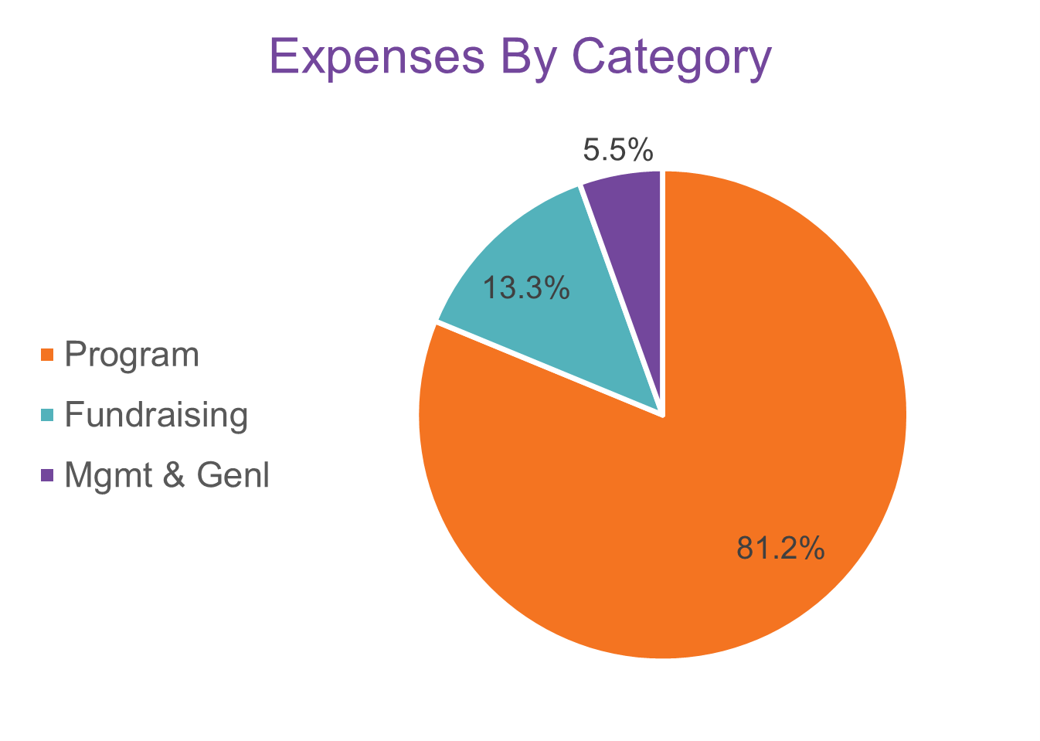
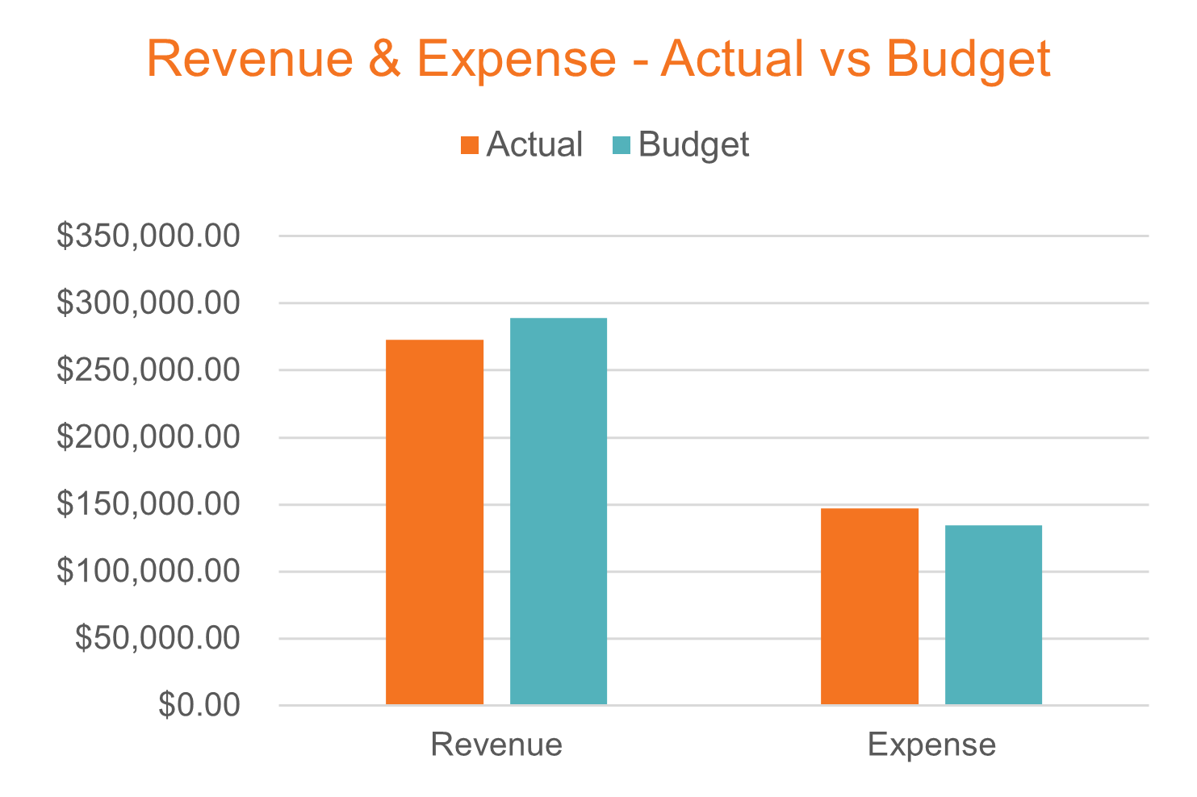
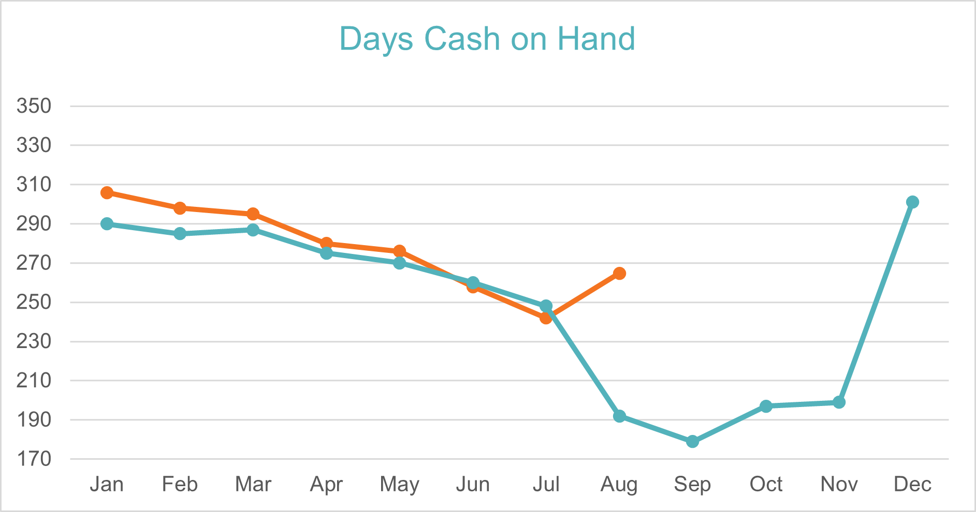
Finance Snapshot
October 2023
Program | 81.2% | $119,226
*Fundraising | 13.3% | $19,509
*Mgmt & Genl | 5.5% | $8,050

Slide 17
New Facility Update
LaChelle Williams | Steve Nash

Slide 18

New Facility - DEED
Action steps:
Assigned DEED Project Manager
Determine Location
Submit project agreement and project use paperwork
Submit project pre-design for approval
Once approved, begin project steps with MMB and DEED

Slide 19
New Facility – Building Committee
Building Committee Chair: Steve Nash (Past Board Chair – Attorney)
Committee Members: Paul Ekstrom (Real Estate), Bill Brass (retired PM with Morcon) Bob Malecha (Civil Engineer and facility construction), Anita Lancello Bydlon (Real Estate, design, and construction management), XXX (?Architect?), XXX (?open?)
Ad hoc members Ron Van Heuveln (PM and CM plan review), Matt McCoy (Fire and Life Safety review)
Committee Objectives:
Provide support and oversite to the HOPE 4 Youth’s new facility project with location site prep, design, construction, Owner’s Rep selection recommendation (if appropriate), RFP process for design and construction, and budget adherence.

Slide 20
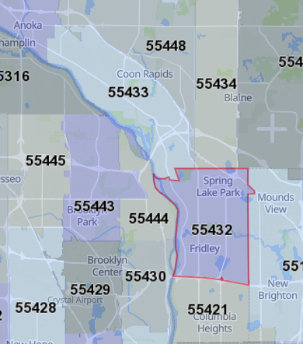
New Facility - Location
Ideal Option:
Northern Fridley
Zoned - Commercial
Within .5 miles of public transportation
Within the census track for NMTC

Slide 21
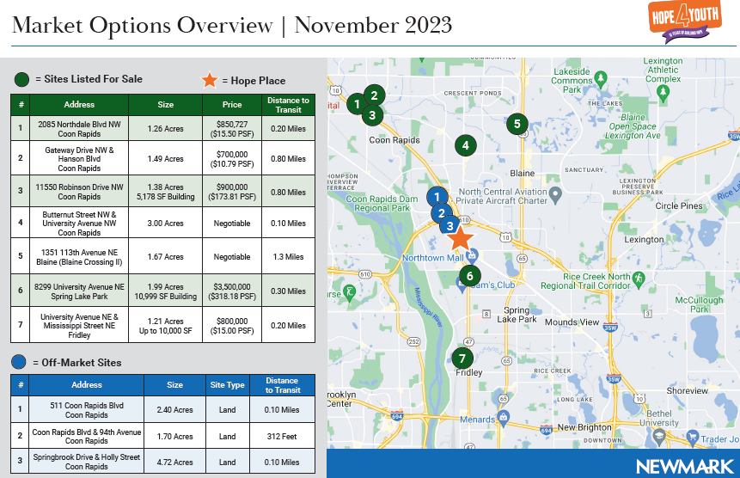

Slide 22
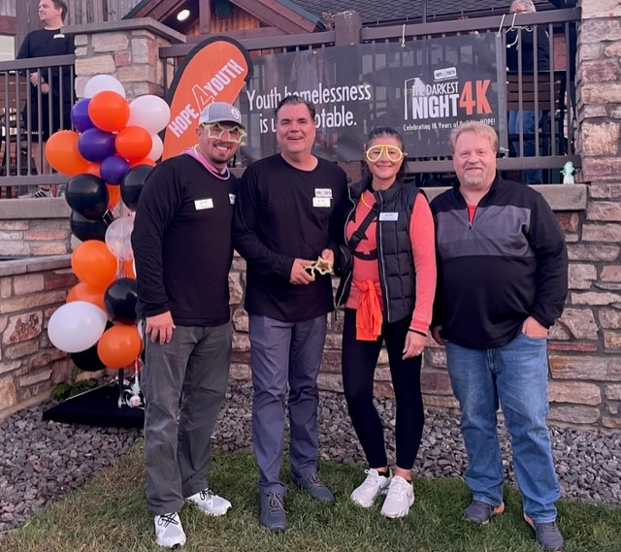
New Facility - Board Support
Location connections
Event participation – mission amplification
Committee engagement
  Program – Prgm asset recommendations
  Finance – Ops budget oversight
  Development – Fundraising/Marketing
  Strategic Steering – Vision and Risk Mngmt
  Executive – Project oversight with expenditure approval

Slide 23
Annual Meeting

Slide 24
Annual Meeting
Chair > Anna VonRueden
Vice Chair > Julie Cole
Treasurer > Don Phillips
Secretary > Linda Barnum
Past Chair > Steve Nash
No Bylaw or policy changes
Slate
of
Officers

Slide 25
Annual Meeting
Revenue - $1,995,280
Expense - $1,990,419
Deficit/Surplus – 4,861
*Defer to Budget Narrative and Budget Worksheet
2024
Budget
Proposal

Slide 26
Open Business
All

Slide 27


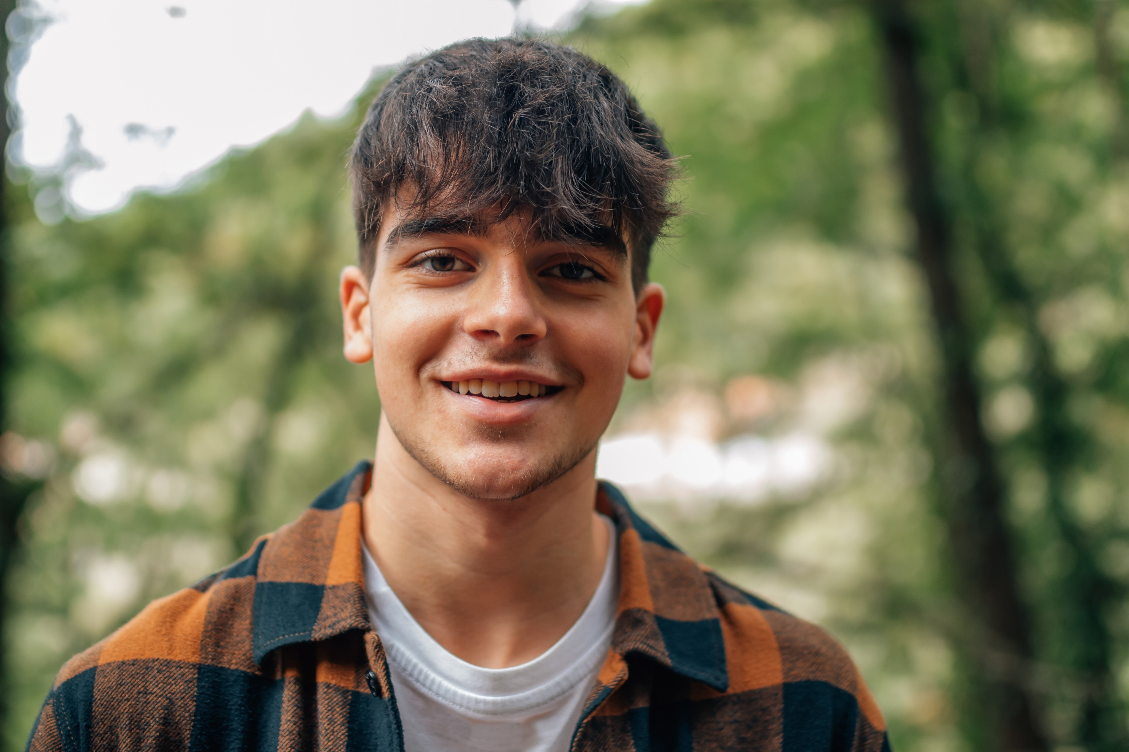
Thank You for a GREAT Year!

