Slide 1


Governance Board Meeting
September 25, 2023

Slide 2
Welcome
Steve Nash

Slide 3
Mission Moment
LaChelle Williams

Slide 4
Chairman’s Report
Steve Nash

Slide 5
Minutes and Agenda
Welcome - Sept Board Meeting
  Chairman’s Report
  Strategic Discussion:
    2024-2026 Strategic Plan and Risk Management Plan vision
  Advancement Update
  Program Update
  Finance Report
  Operations Update
  Open Business
  Adjourn
Approval
of
July
Minutes

Slide 6

Executive Committee Update
Board meeting preference
  Monday 5p-7p
November Annual Meeting
Timeline for budget approval
Nominees for the Board
  James Lyght
  Liz Cook

Slide 7
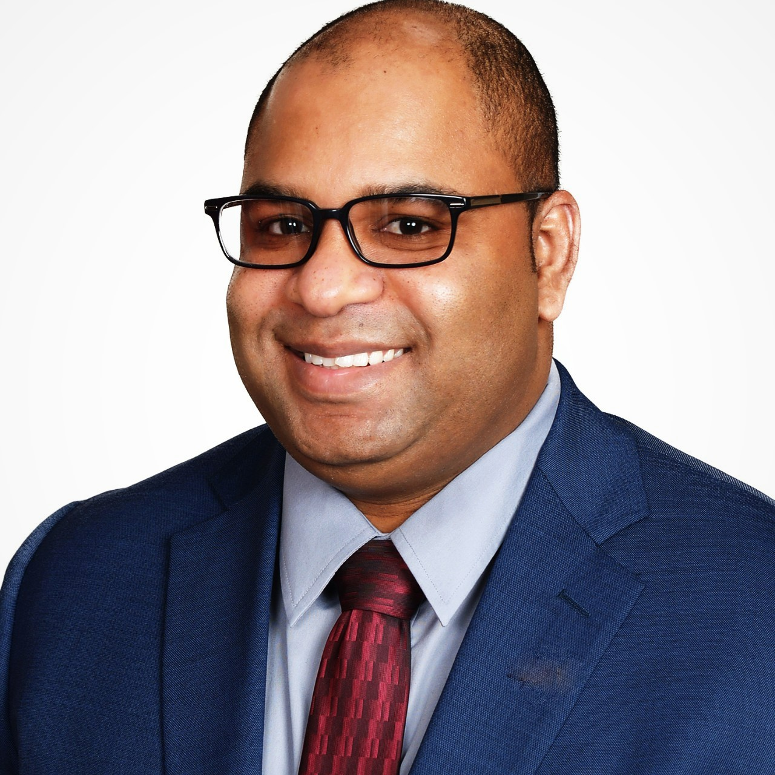
James Lyght
James Lyght is a Vice President | Nonprofit and Commercial Banking with Bremer Bank. He is an Anoka resident with his wife Laura and two sons Eli (3 years) and Leo (7 months). James graduated in 2014 from the University of North Dakota. Before joining Bremer Bank in 2021, James spent 7 years with J.P. Morgan Private Client Group and U.S Bank Wealth Management. He enjoys spending time with his family, traveling, and all things sports.
His goal is to be a great board member for H4Y through collaboration, ideas, and resources.
LinkedIn profile

Slide 8
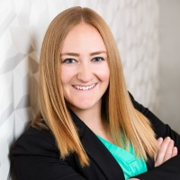
Liz Cook
Liz Cook, CPA, is a manager at CLA on the Principle Track with an expertise in nonprofit financial management. She has served in the role of leading nonprofit audits for eight years with CLA. Her clients include various social service organizations, foundations, and other unique nonprofits. Liz truly enjoys the aspect of helping others make positive change ultimately improving their communities. Liz grew up in the Twin Cities but went to college at the Univ of Arizona. Liz currently lives in Maple Grove with her husband Drew and their dog Doug.
LinkedIn profile

Slide 9
Building our FUTURE
Sue Woodard | Strategic Steering Committee

Slide 10
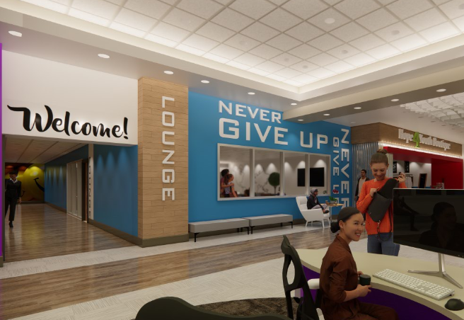

2024-2026 Strategic Plan
and Risk Management
Board & Committee Review
Strategic Plan Approval
Risk Management Plan process

Slide 11
Strategic Goal & Objectives: One
  Provide life-enhancing programs empowering youth to reach their full potential
    Deliver premier programs using the four-fold approach
    Create a center of support at the Drop-In Center addressing immediate and long-term needs
    Create a thriving place to live at HOPE Place to fully launch youth into the community
    Expand social & emotional well-being program offerings and resource partnerships

Slide 12
Strategic Goal & Objectives: Two
  Engage in transformational partnerships with community leaders, donors, and volunteers
    Strengthen partnerships with community leaders focused on homelessness and youth empowerment to provide imperative resources for our youth
    Enhance donor relations to build transformational relationships
    resulting in innovative revenue generation
    Enhance volunteer opportunities and experience driving retention and increased engagement.
    Strengthen all stewardship efforts to foster greater connection and funder alignment to strategic priorities

Slide 13
Strategic Goal & Objectives: Three
  Laser focus on premier staff retention and operational improvement
    Strengthen a transparent culture driving team engagement
    Deepen employee benefit expansion to elevate attractiveness and retention
    Ensure HOPE 4 Youth sustains an inclusive, equitable, and diverse culture
    Embody a strengths-based mindset, behavior, and actions

Slide 14
Strategic Goal & Objectives: Four
  Determine viability, location, and funding plan for new HOPE 4 Youth (Drop-in) Center
    Feasibility study
    Explore legislative funding
    Explore capital campaign
    Explore new rental options

Slide 15
Advancement Update
Nikki Kalvin | JJ Slag

Slide 16
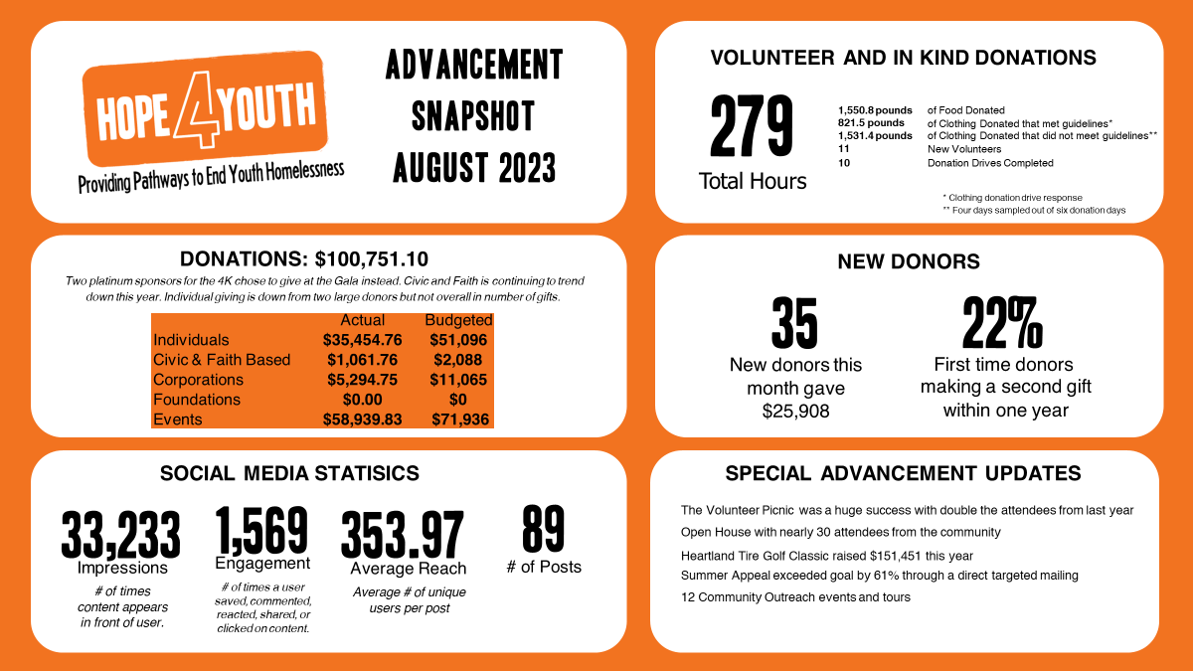

Slide 17

Advancement Update
Recap Q3 Events
Q4 – Activities and Events
Discussion/ Action Item: What words/ phrase for rebrand and launch of Monthly Giving?

Slide 18
Program Update
Mark McNamer | Anna VonRueden

Slide 19

Program Update
Program Committee New Members
Focus on Innovative Mental Health Supports (yoga, art, music, sports)
Safety and Security
MOU w/Saint Mary's
New Funding for Housing Supports

Slide 20
Financial Report
Brooke Limanen | Don Phillips

Slide 21
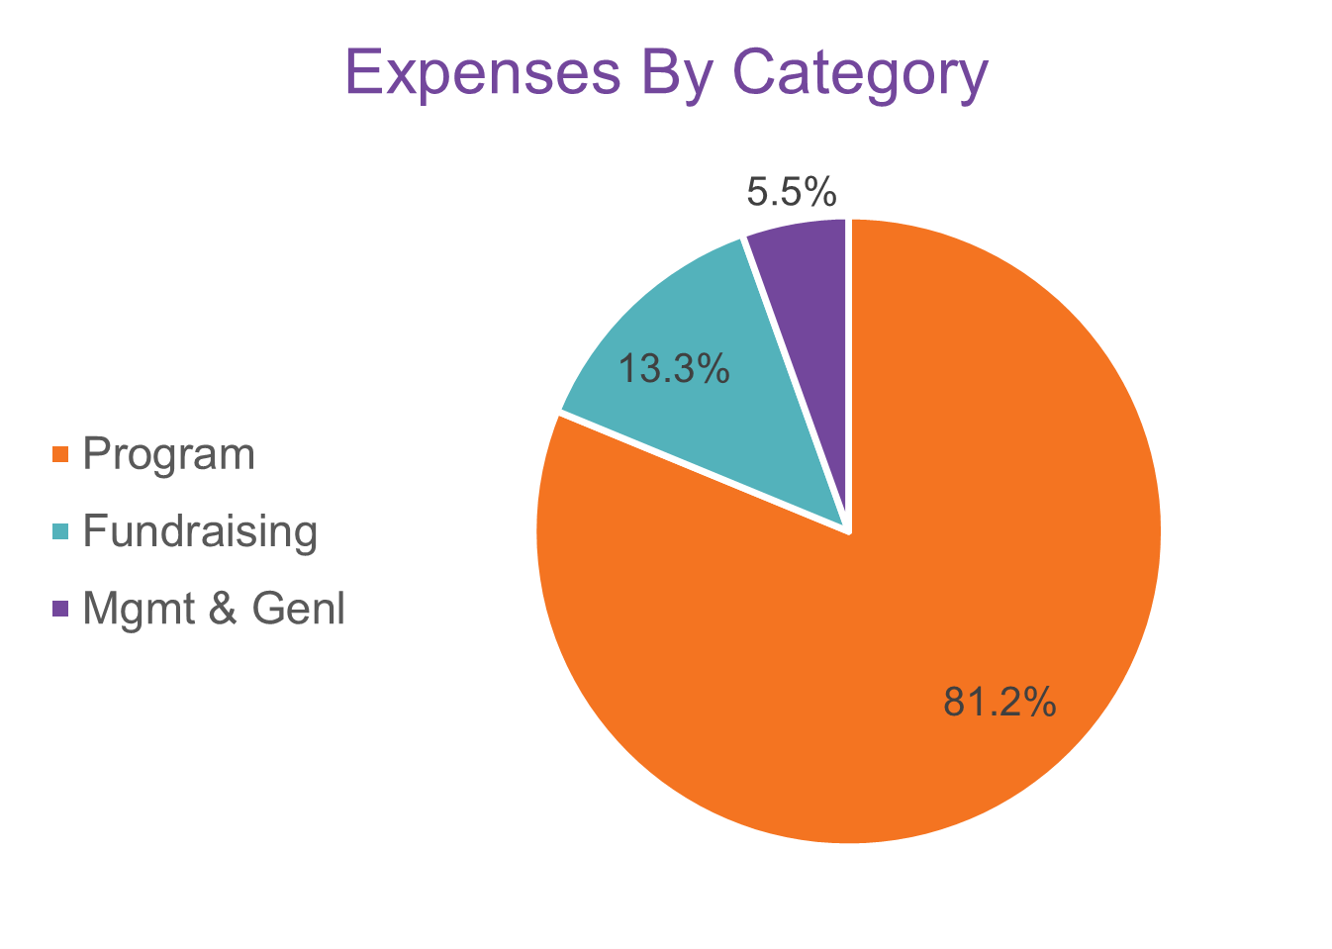
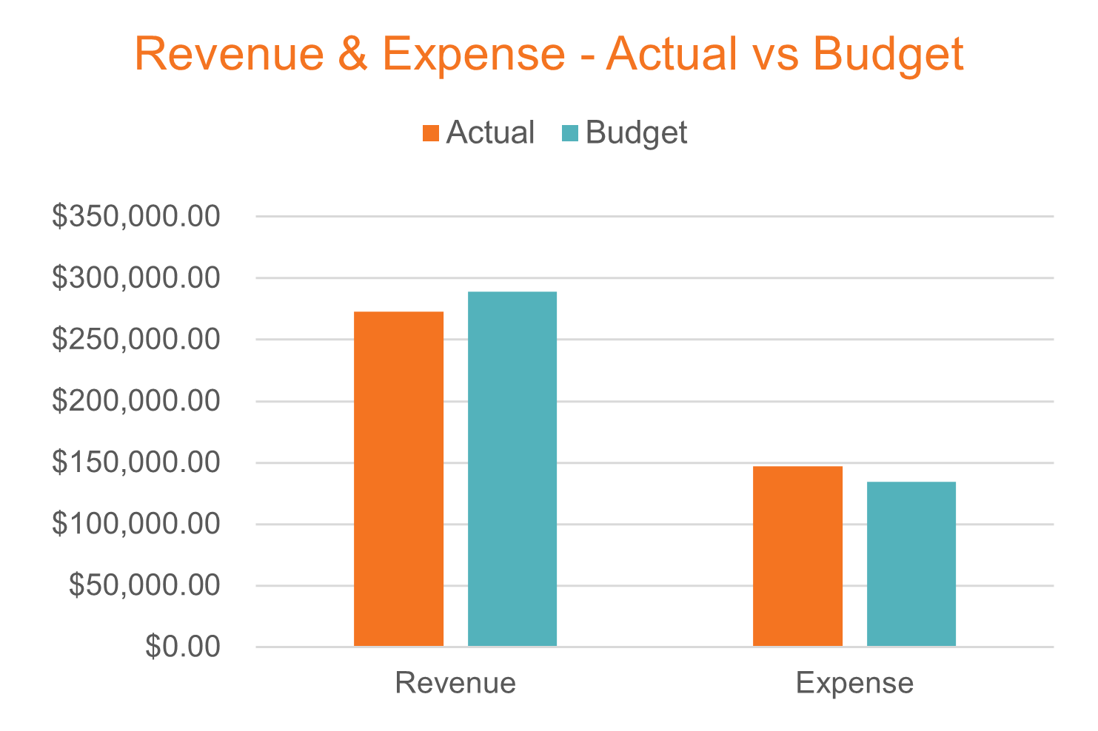
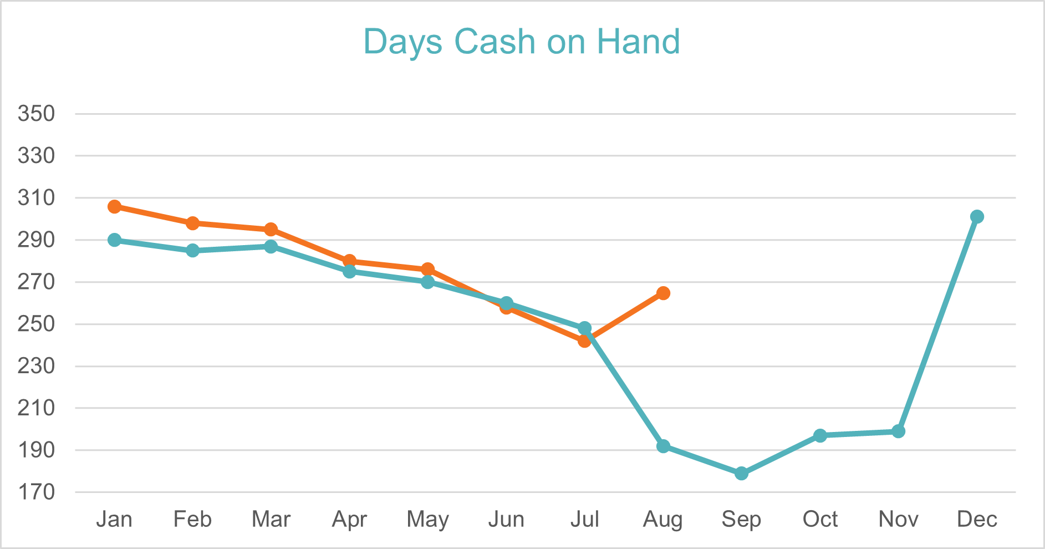
Finance Snapshot
August 2023
Program | 81.2% | $119,226
*Fundraising | 13.3% | $19,509
*Mgmt & Genl | 5.5% | $8,050

Slide 22
Operations Update
LaChelle Williams

Slide 23

Operations Update
Ready for our Final Quarter of 2023
  New Facility Update
  Staff Engagement Survey results

Slide 24
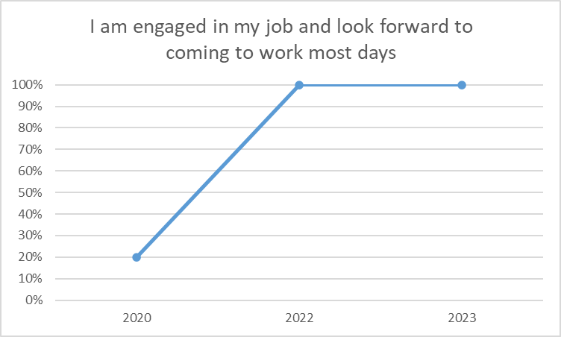
Staff Engagement Survey
Categories
  Communication
  Comp & Benefits
  Development
  Engagement
  Manager & Support
  Mission & Purpose
  Respect for employees
  Satisfaction
  Work-life balance

Slide 25
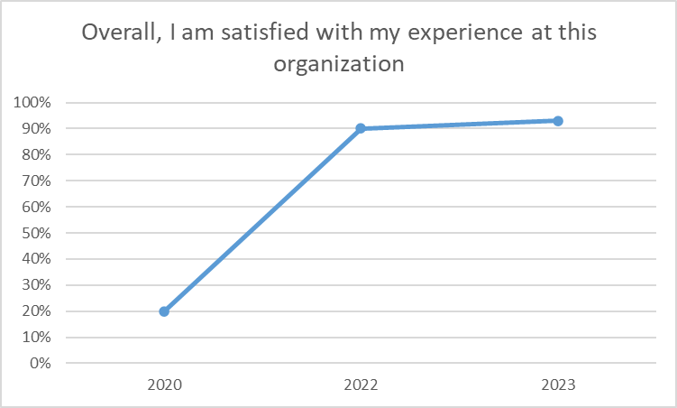
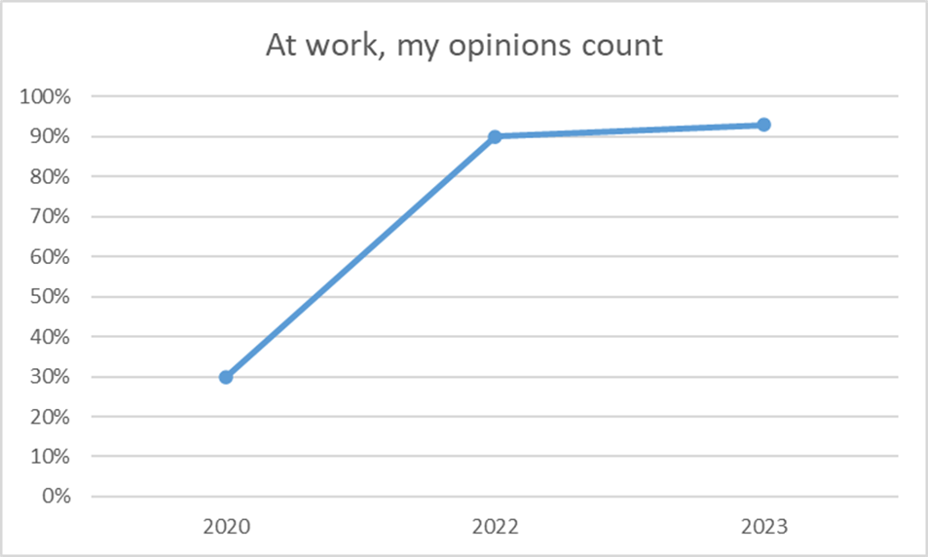
Staff Engagement Survey

Slide 26
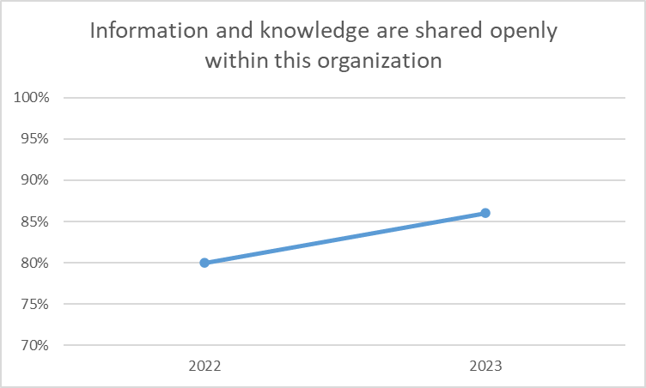
Staff Engagement Survey
100% of staff reported:
“I understand how my role contributes to the mission of this organization”
“I have the tools to enable me to do my job effectively”

Slide 27
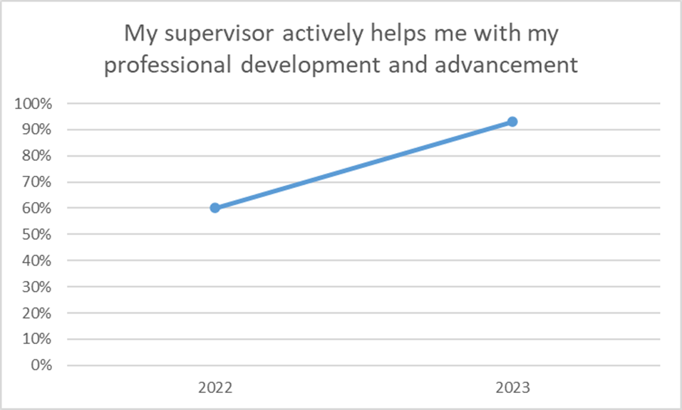
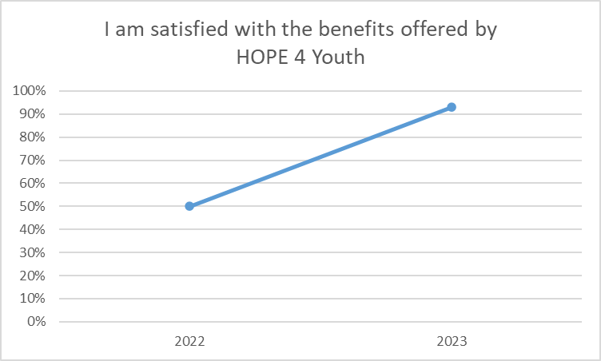
Staff Engagement Survey

Slide 28
Improvement Plan
Communication
  Streamline messages
  Ask more questions
  Utilize the L-10 meeting structure
  Use our All-Staff meetings and TEAMS platform
Professional Development
  Deeper focus within annual review process
  Discuss roadmaps for advancement
  Socialize opportunities both horizontally and vertically

Slide 29

Improvement Plan
Staff Engagement
  Leadership be present; ask questions
  Empower team to make decisions
  Creatively add team-building activities
  Intentionally create touchpoints to get to know one another

Slide 30

Together we are BETTER
Plans for ongoing focus
  Communication
  Comp & Benefits
  Development
  Engagement
  Manager & Support
  Mission & Purpose
  Respect for employees
  Satisfaction
  Work-life balance

Slide 31
Open Business
All

Slide 32


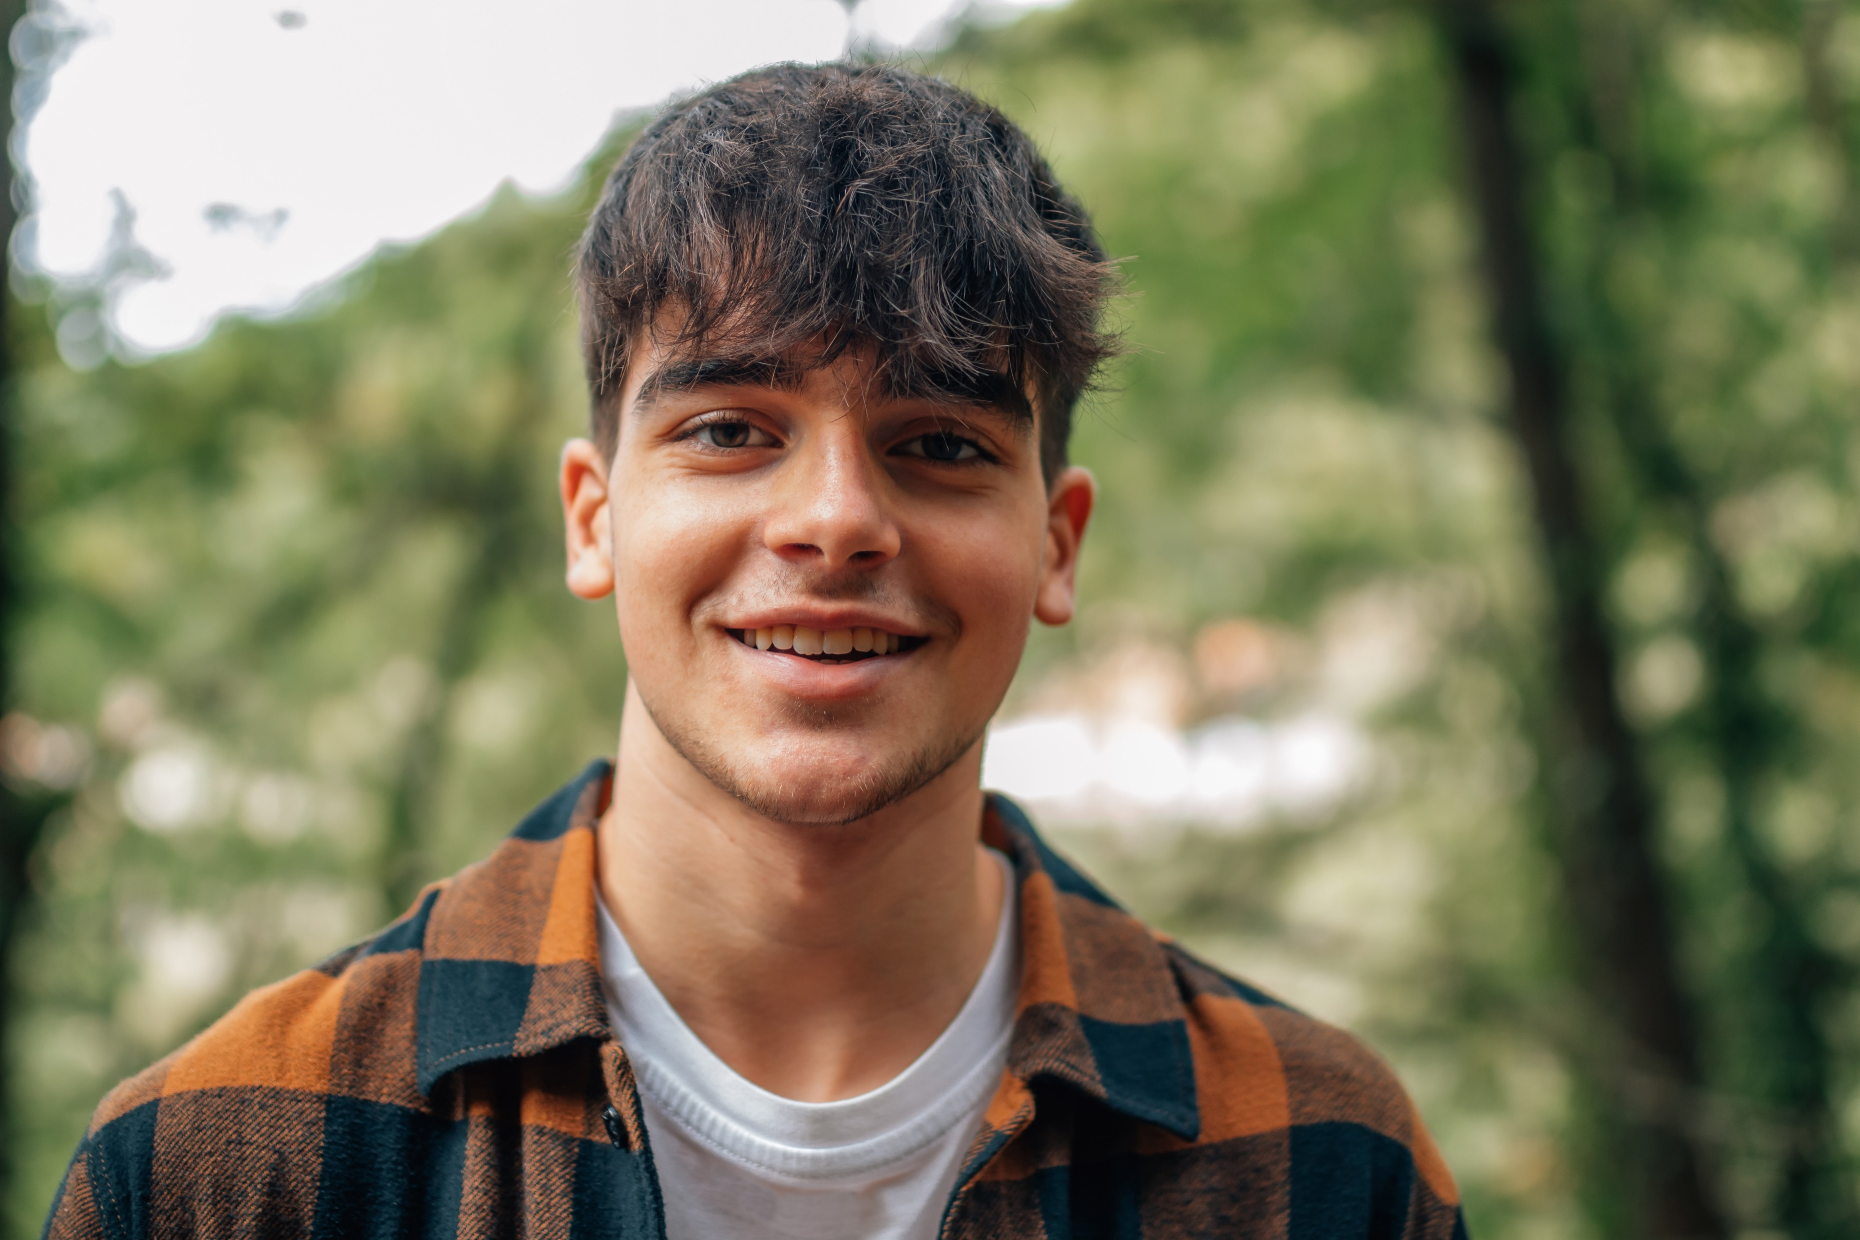
Thank You!

