Slide 1


Governance Board Meeting
May 19, 2025

Slide 2
Welcome
Krista Benjamin
Share:
What’s one modern day technology you can’t live without?
What’s one modern day technology you haven’t embraced?

Slide 3


Mission Moment
HOPE 4 Youth’s Mission in the words of our youth
Mark McNamer

Slide 4
Minutes and Agenda
Approval
of
March
Minutes
  Chairman’s Report
  Strategic Discussion | Operational Updates:
    Ops Snapshot – Positioning Discussion
    Building HOPE Project Update
    Audit Presentation and Financial Snapshot
    Advancement Snapshot
    Program and Facility Update
    Open Business
  Adjourn

Slide 5
Chairman’s Report
Krista Benjamin

Slide 6
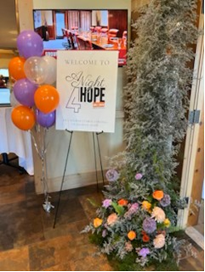
Executive Committee Update
Celebrations!
  A Night 4 HOPE
  Building Update – We have a location
  Audit Presentation – James will report in the Finance Update
  Operational Growth
Fall Retreat – SAVE THE DATE September 18
Advisory Committee
Board nomination – Bri Clarin

Slide 7
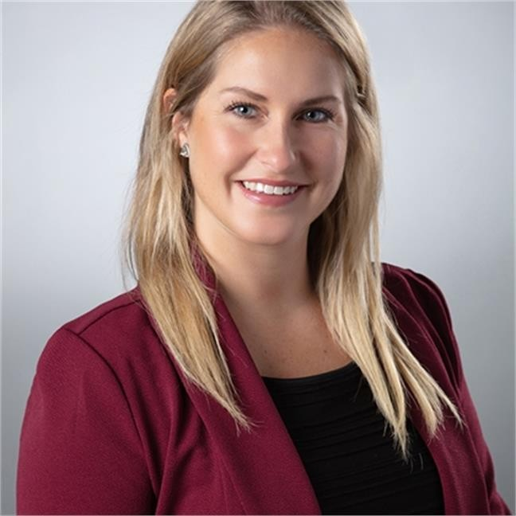
Board Nominee – Bri Clarin
Bri Clarin is a dynamic leader with over a decade of experience in healthcare operations, financial management, and revenue cycle optimization. Known for her strategic insight and results-driven approach, Bri excels in driving operational efficiency, enhancing financial performance, and fostering collaborative environments to achieve organizational goals. She has played pivotal roles in financial due diligence for mergers and acquisitions, as well as in implementing systems that streamline healthcare operations and compliance.
Beyond her professional achievements, Bri is deeply committed to community service and believes in leveraging her expertise for meaningful impact. Her personal connection to the issue of youth homelessness, shaped by family experiences, fuels her passion for creating opportunities that ensure stability and growth for vulnerable populations.
Bri currently serves on the Associate Board of the Women’s Health Leadership TRUST, where she chairs the Wellbeing Retreat and contributes to program development that empowers women in their careers. Her top strengths—discipline, strategic thinking, individualization, and deliberative leadership—underscore her ability to make informed, thoughtful decisions that drive success.
In joining the HOPE 4 Youth Board of Directors, Bri seeks to contribute her financial acumen and leadership skills to further the organization's mission, ensuring every young person has a safe place to call home and the resources to thrive.

Slide 8
Operational Snapshot
LaChelle Williams

Slide 9

Operational Snapshot
  Ops Plan Update
  Navigating the Environment
    External factors
    Government | Visits | Economic realities
  Streamline Focus

Slide 10
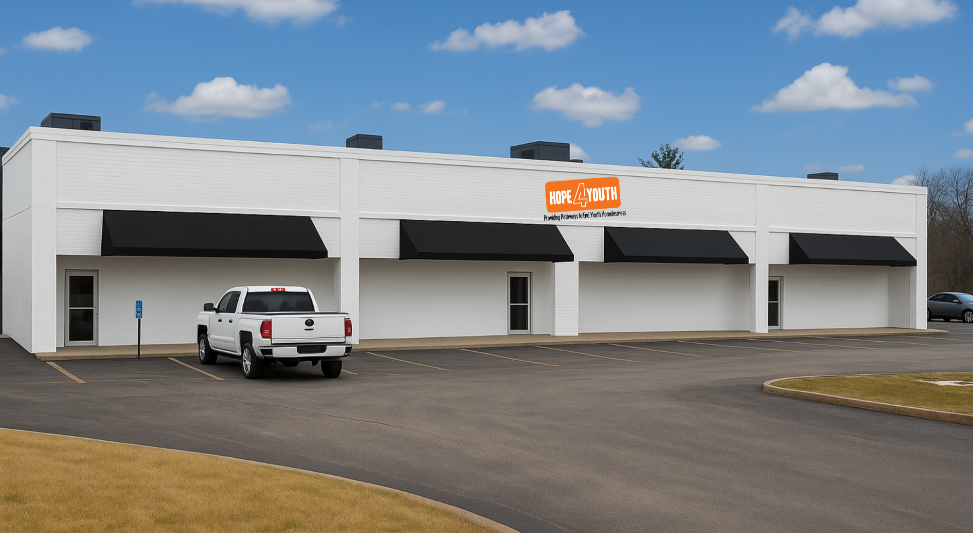
New Facility
LaChelle Williams | Steve Nash

Slide 11
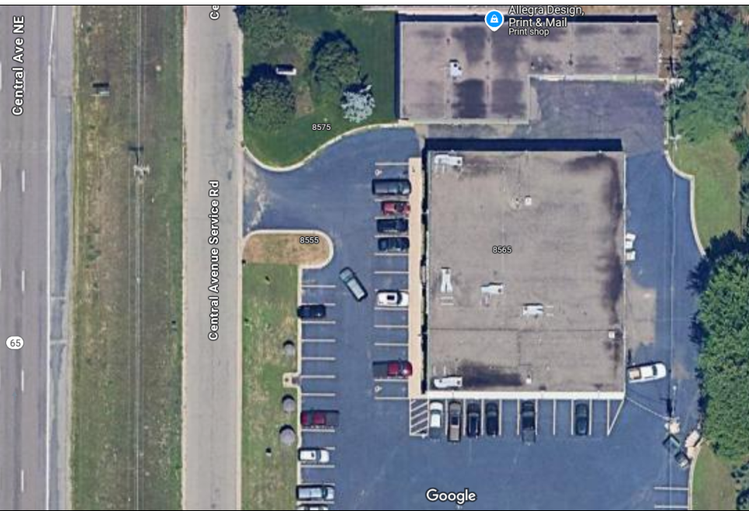

FACILITY
8565 Central Ave NE, Blaine - 11,790 SF
ROADMAP
Letter of Intent - notify constituents
Construction firm RFPs out
Construction Interviews completed
Purchase Agreement – In negotiation
Reinstate work DEED
Started application process for bridge loan
Construction firm selected – After estimate
Engage in design and construction

Slide 12

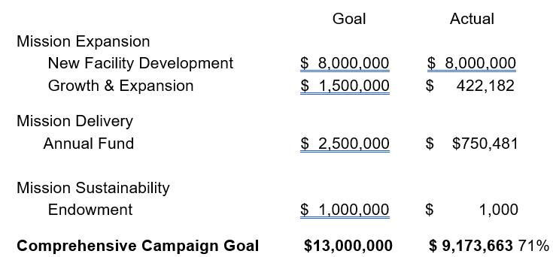
Comprehensive Campaign

Slide 13

Where we need you
Join our Comprehensive Campaign Committee
Recommend philanthropic thought leaders to join the committee
Introduce LaChelle to potential donors

Slide 14
Financial Report
James Lyght | Brooke Limanen | Liz Cook

Slide 15
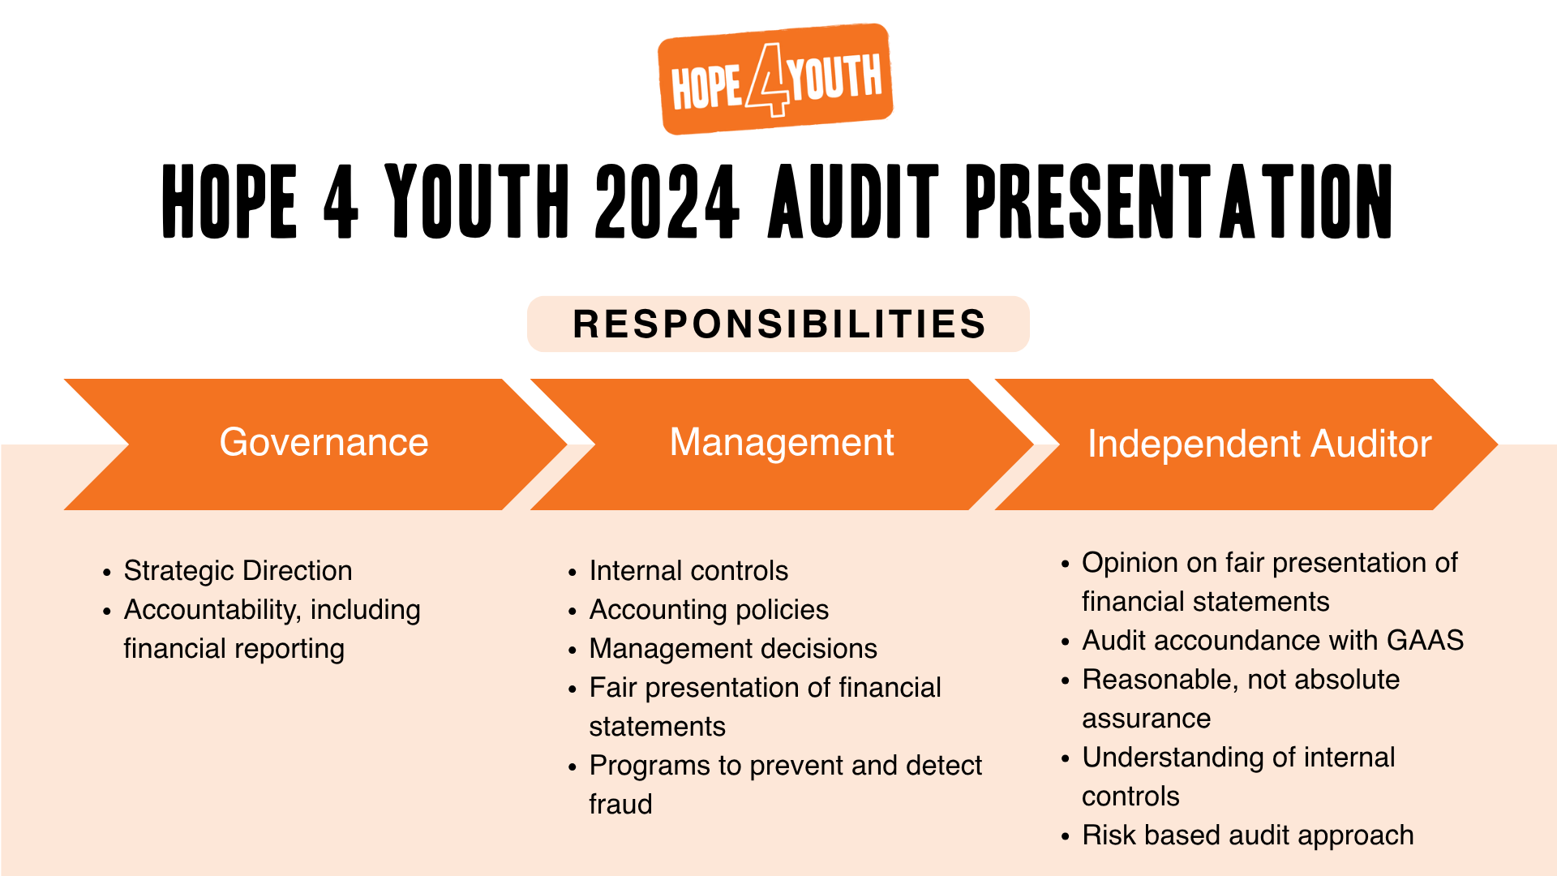

Slide 16


Slide 17
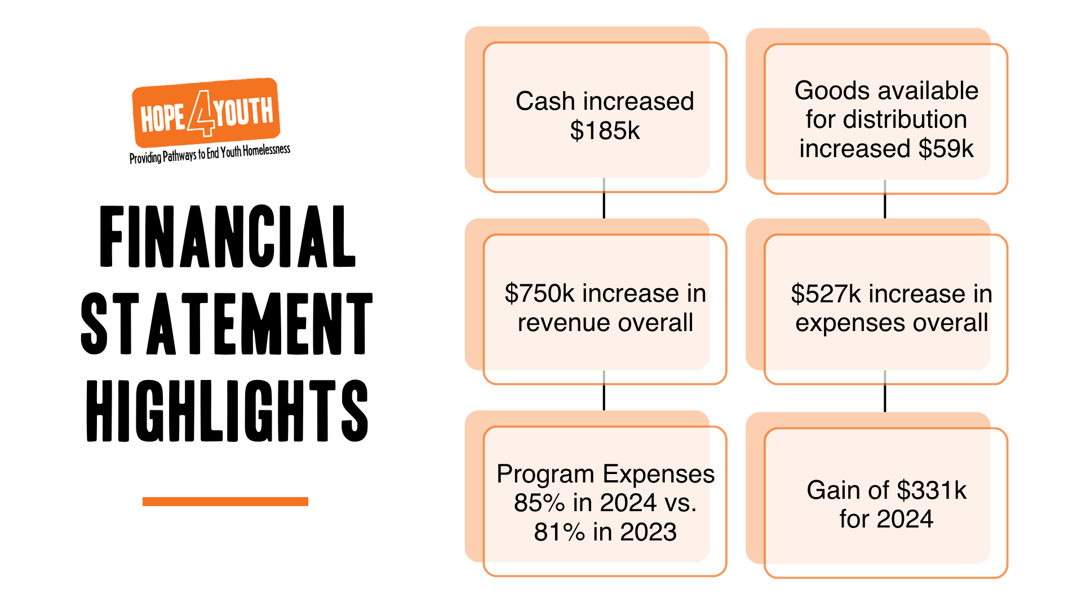

Slide 18
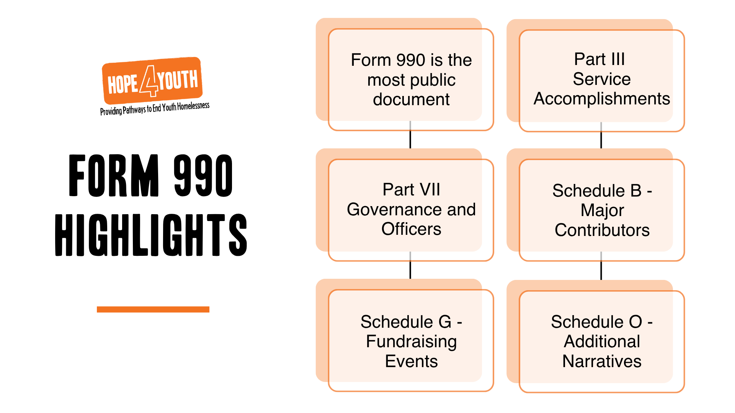

Slide 19
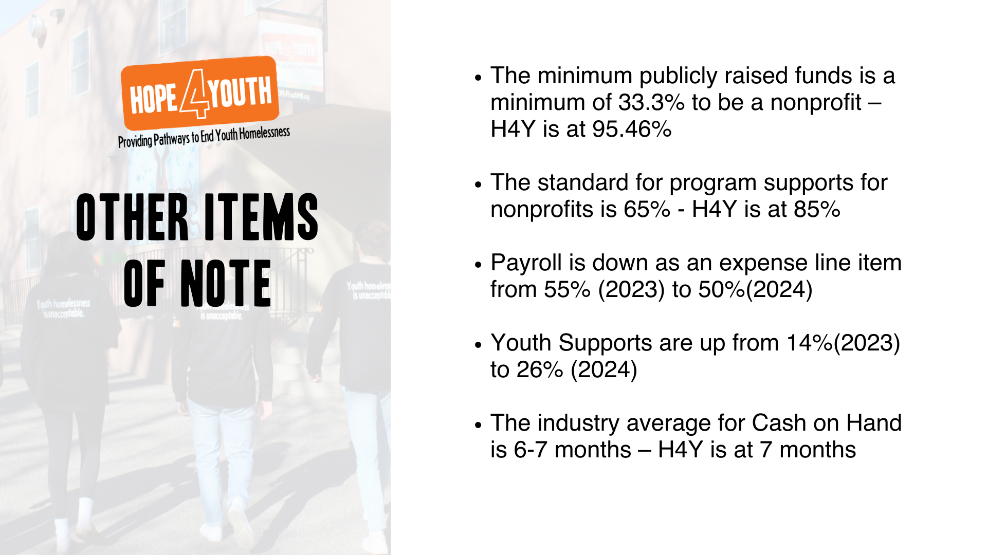

Slide 20

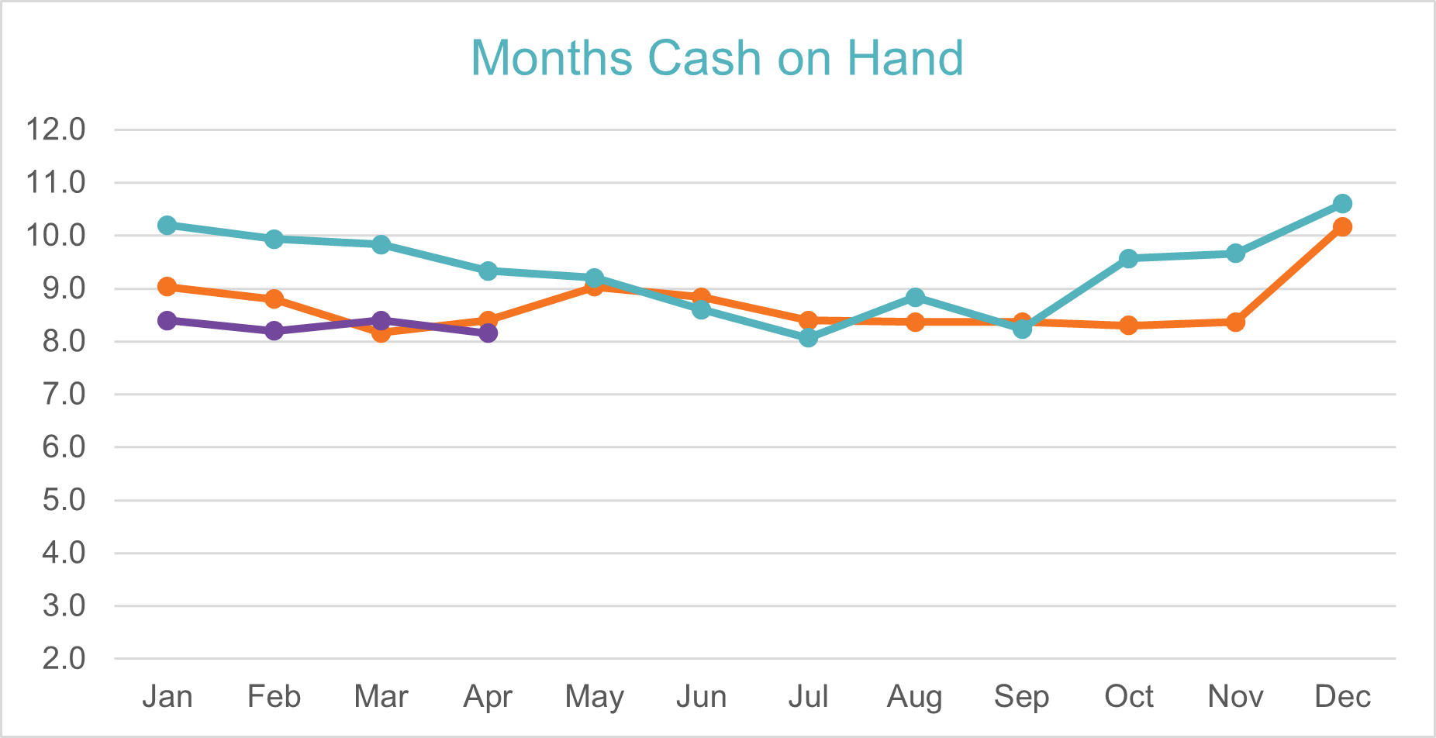
Total Expenses
Less Depreciation
Less In-kind
=
Cash on Hand

Slide 22
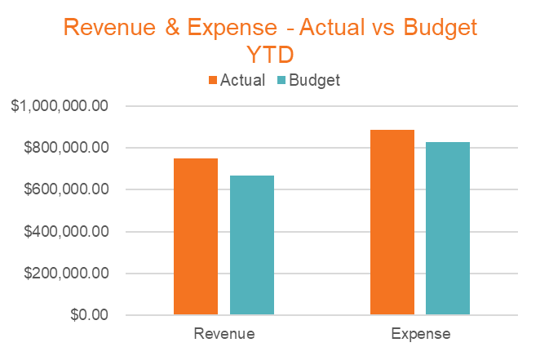

Slide 23
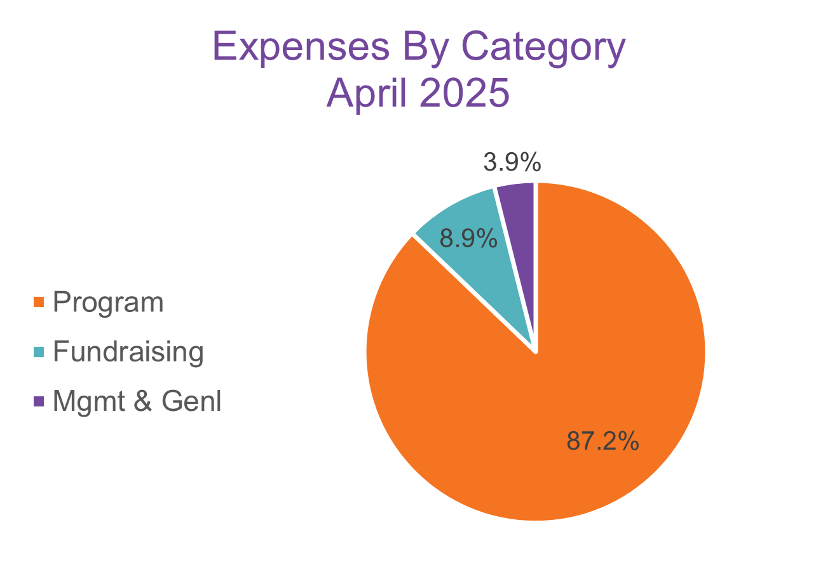
Program | 87.2% | $207,793
*Fundraising | 8.9% | $21,242
*Mgmt & Genl | 3.9% | $9,323

Slide 24
Advancement Update
Paul Moore | Nikki Kalvin

Slide 25
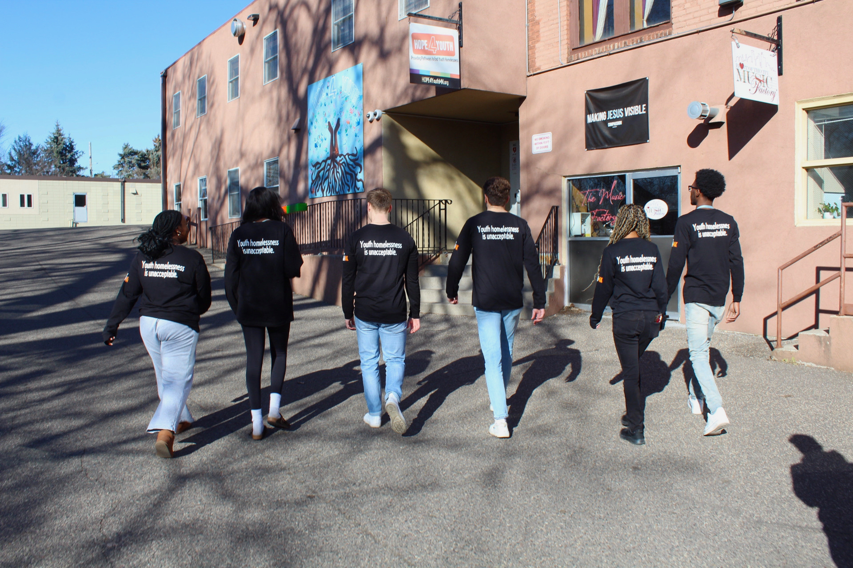
Advancement Team
  A Night 4 HOPE
    Celebrate success
    Suggestions for 2026
  Law Enforcement Appreciation, May 15th
  Pack the Pantry, May 31st kick off
  Partnerships
  Call to Action
    Organizations/ Businesses – connections
    Community Engagement throughout the summer

Slide 26
Facility & Program Update
Mark McNamer | Pat Chen

Slide 27
HOPE Place - Facility Improvements
New Shed
Parking Lot Sealcoating
Landscaping Improvements
New Camera System
Panic Buttons and Intercom
Updated Controlled Access
Updated Community Room
Updated Apartment Units

Slide 28
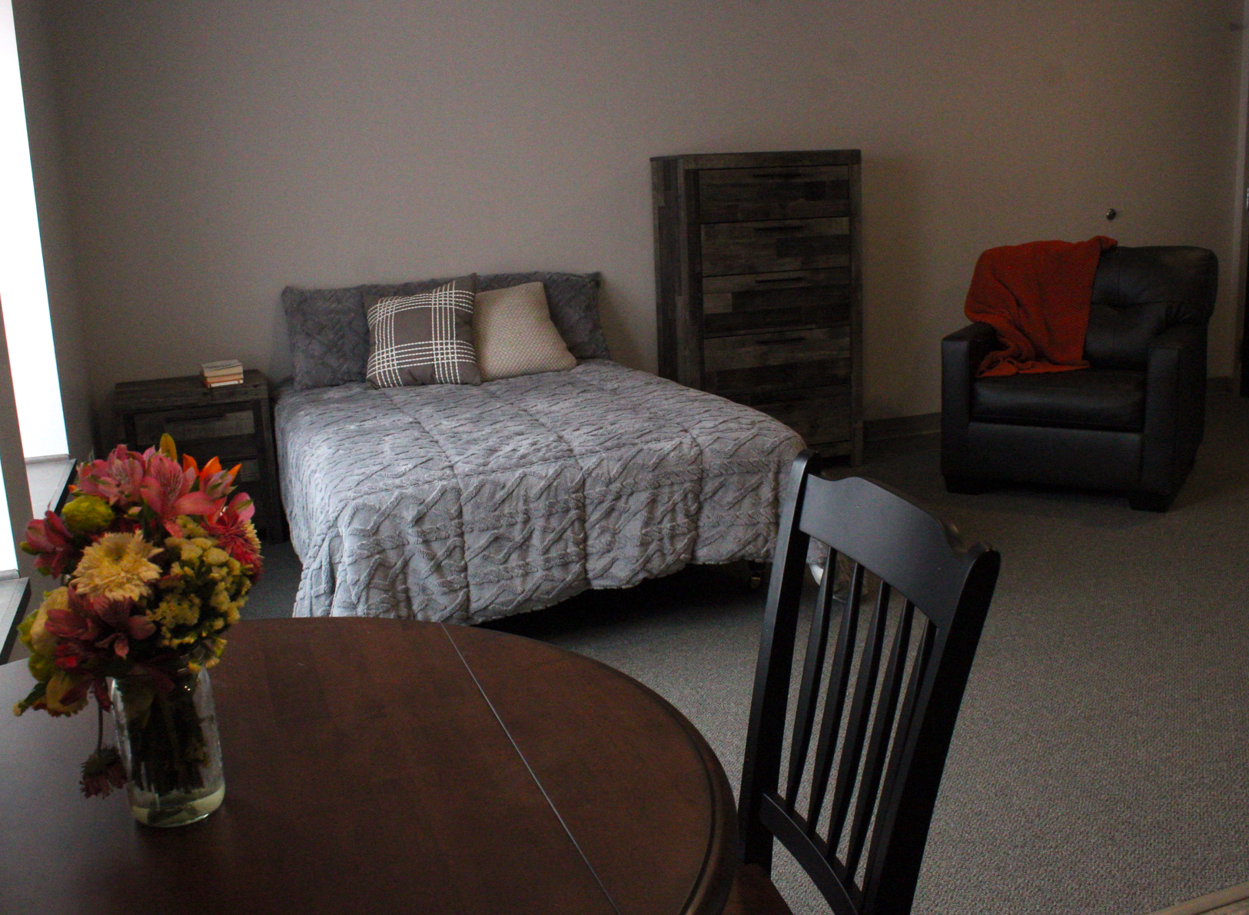
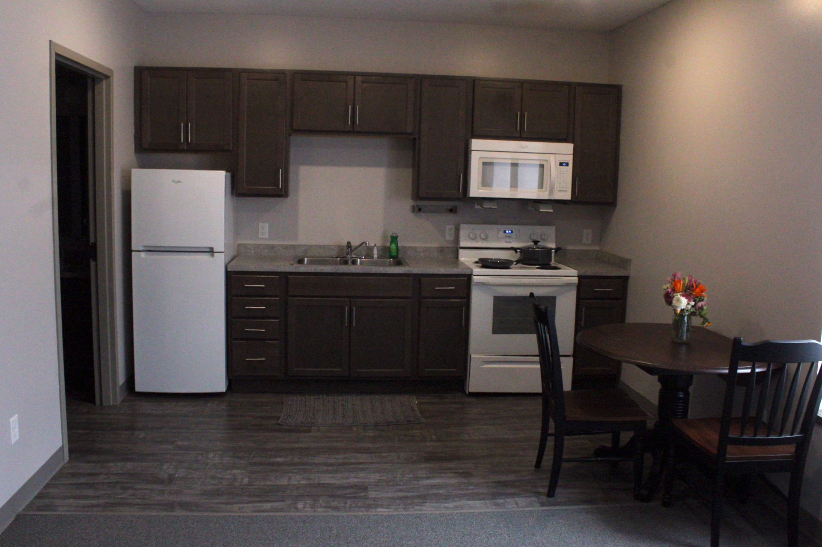

Slide 29
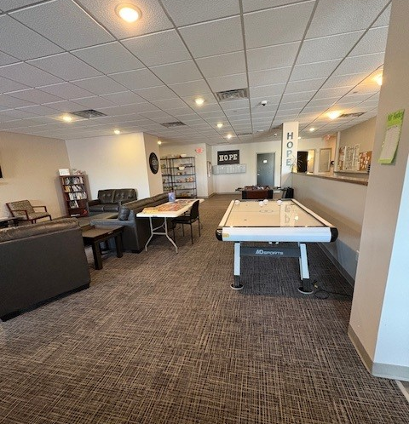
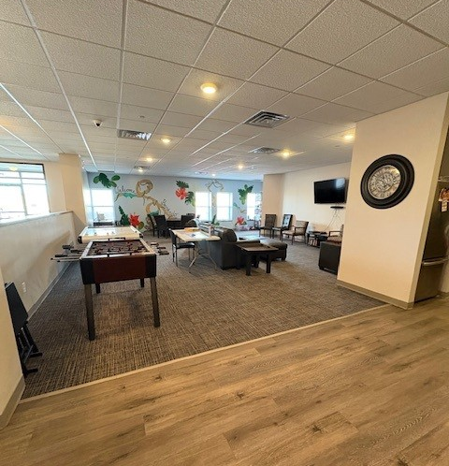

Slide 30
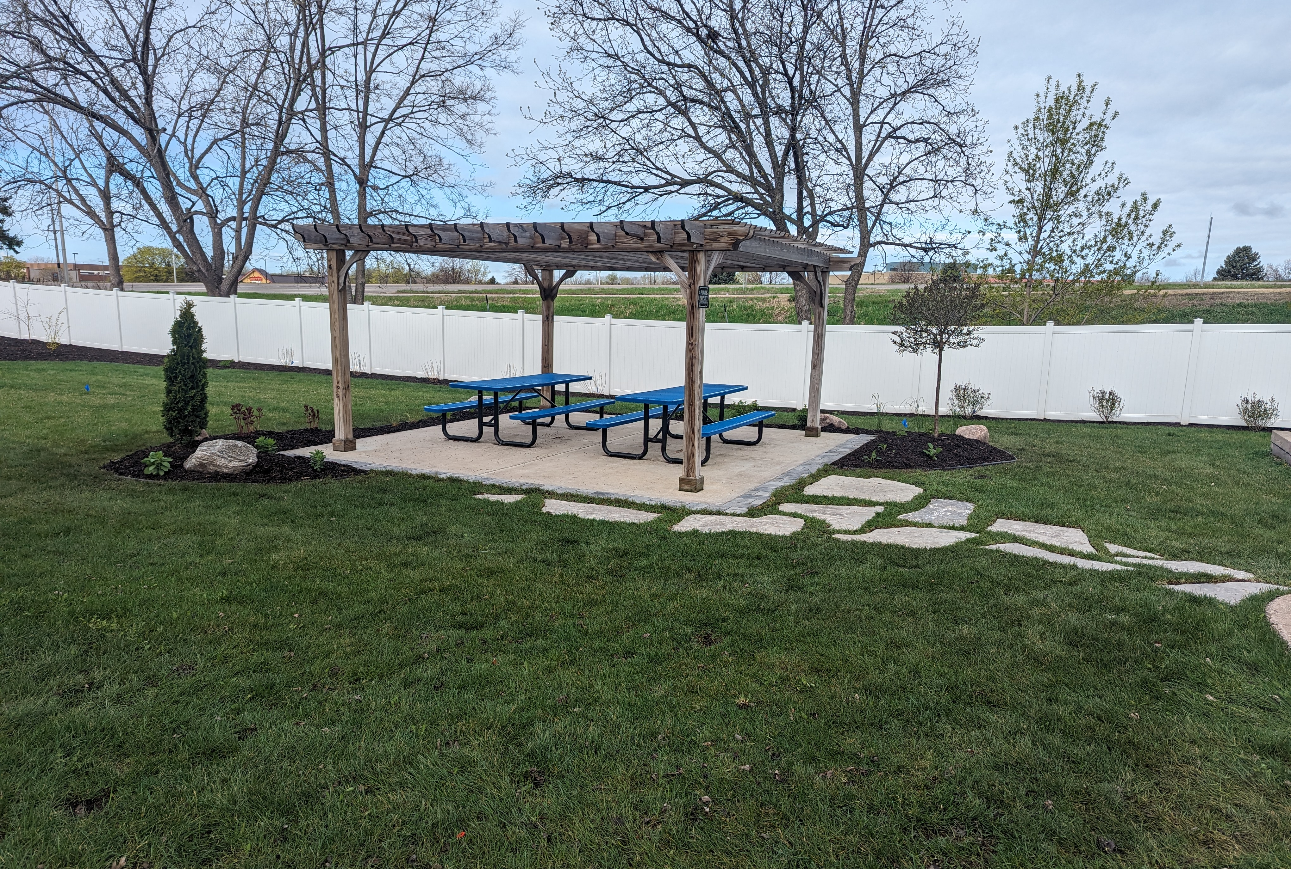
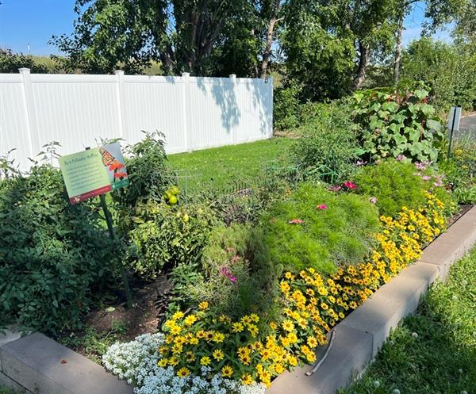
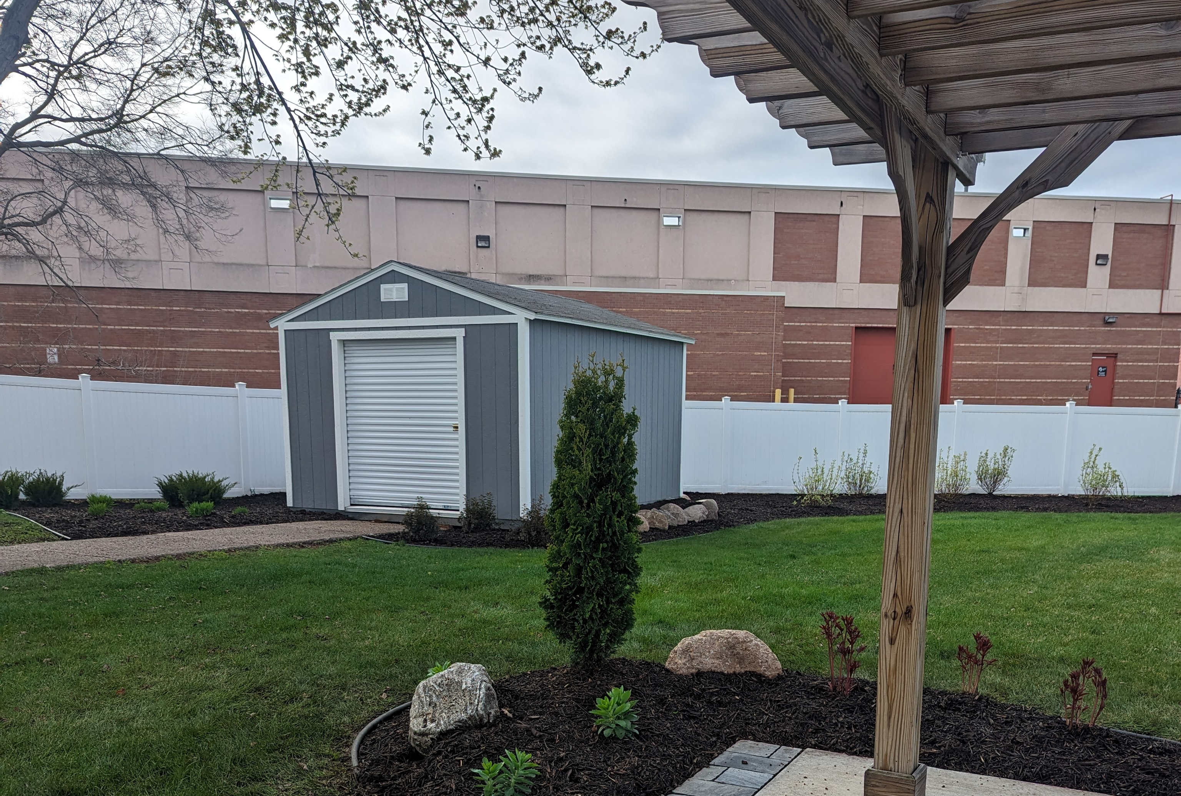

Slide 31
H4Y Center - Facility Improvements
New Front Desk
Moved Clothing Closet to Main Level
Zen Room Updates
Pantry added fresh food options
Kitchen Upgrades
Garden Planters

Slide 32
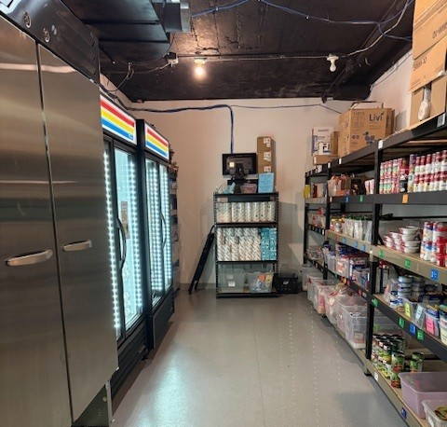
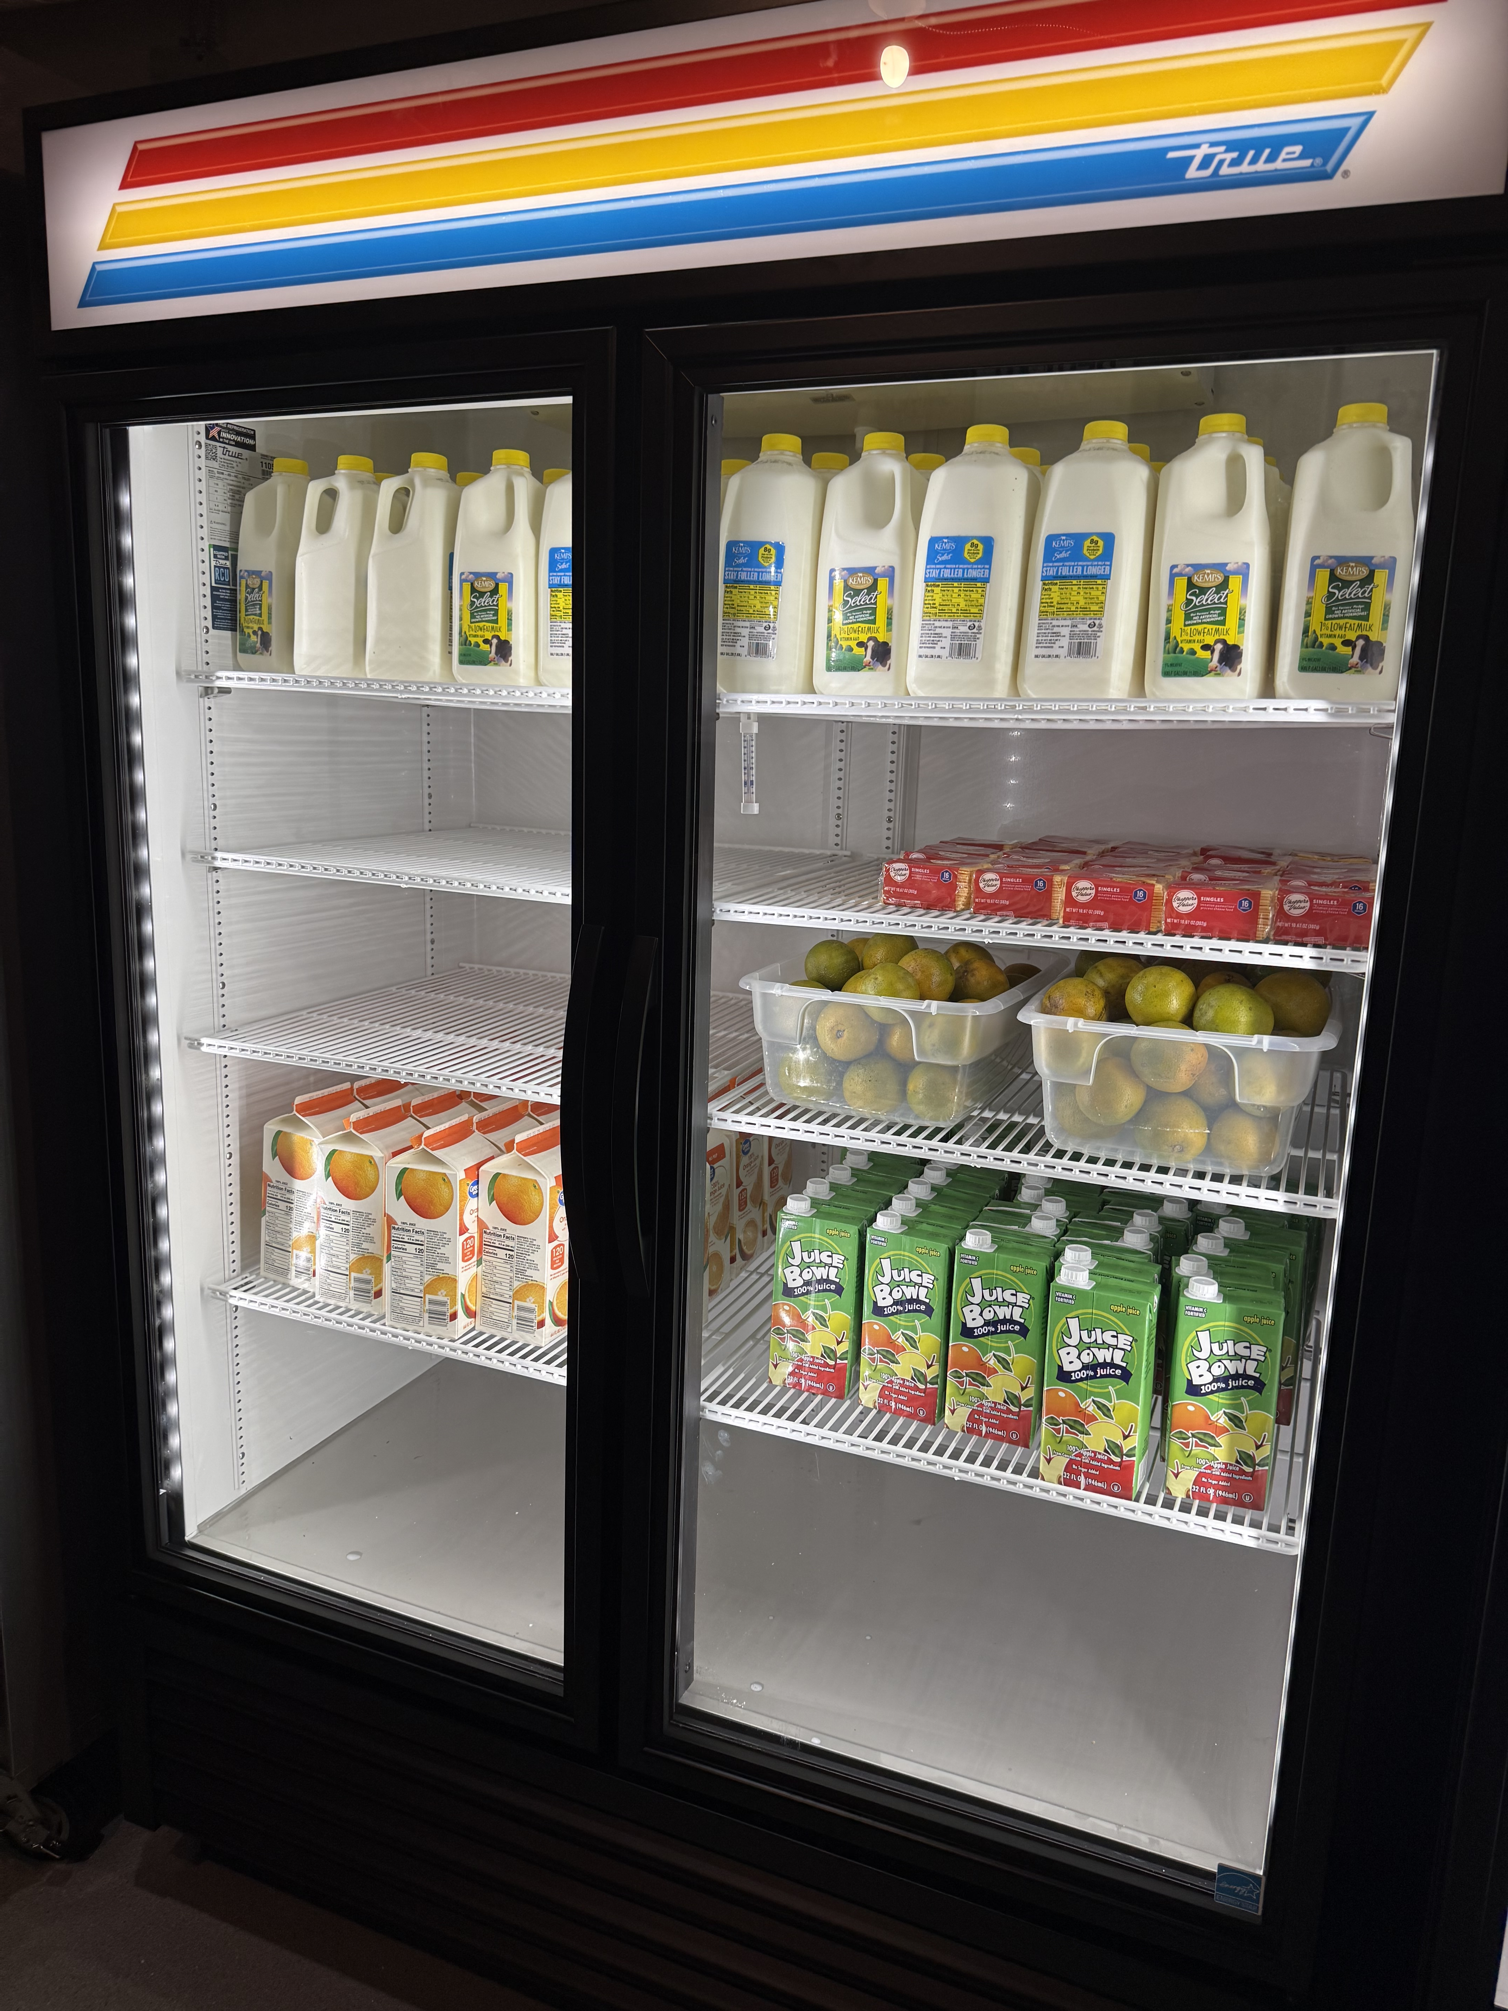
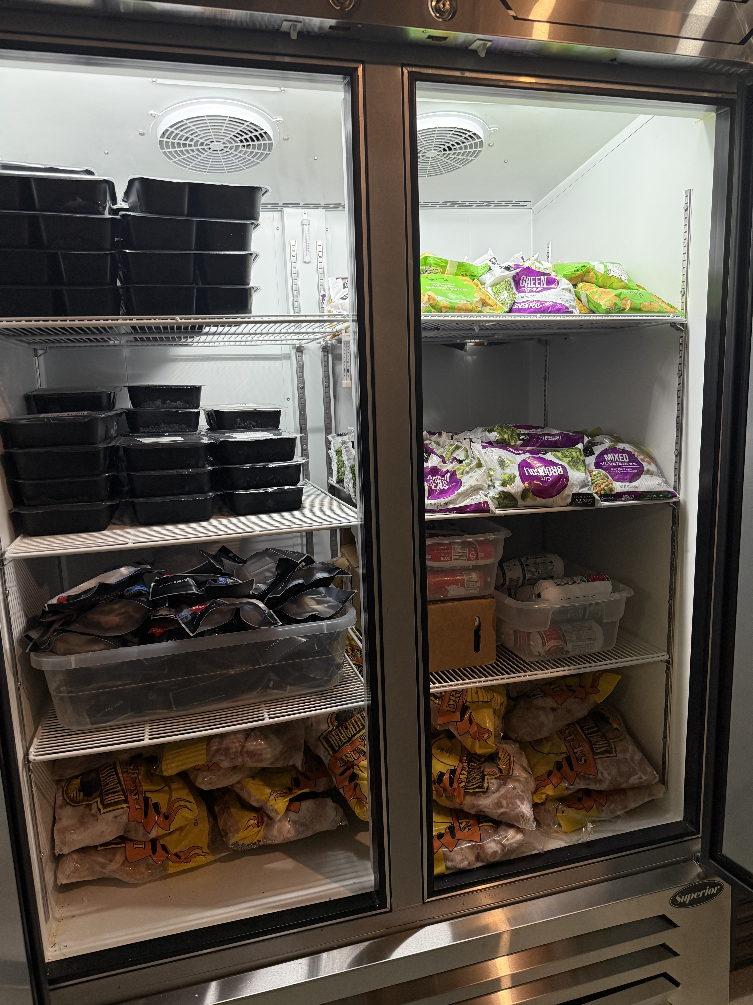

Slide 33
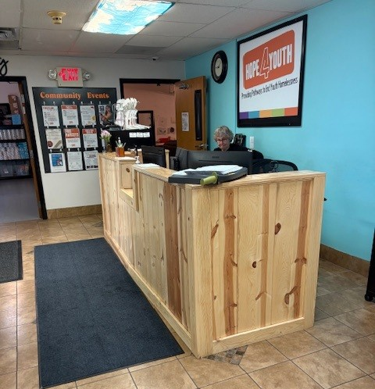
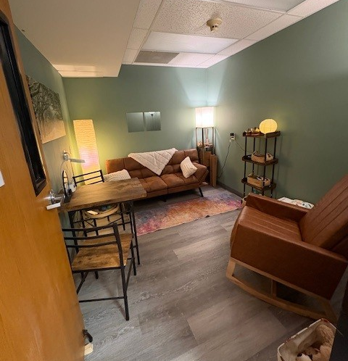

Slide 34
Program Updates
12 youth received over $10,000 in Housing Supports in April
Hope for the Community Partnership (6 weeks = 6,300 #s of food)
2024 vs 2025 YTD - Program
  50% Increase in Youth Served
  65% Increase in Youth Visits
  73% Increase in New Enrollments
April 2024 vs April 2025 - Basic Needs
  54% Increase in Food Shelf Visits
  80% Increase in Clothing Closet Visits
  55% Increase in Meals Served

Slide 35
Open Business
All

Slide 36


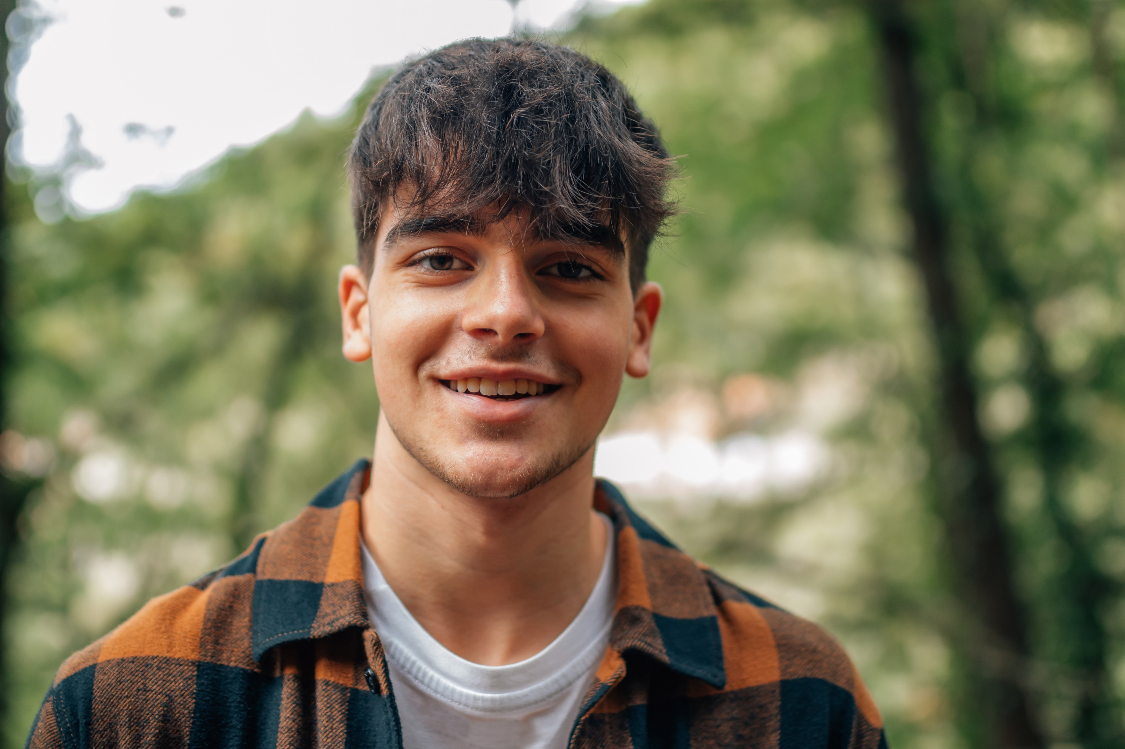
Thank You!

